Slide 1
Antifungal TDM Current Indications and Practical Implementation of Precision Dosing
Controversies and Challenges in Antifungal Therapy
30 April 2024
Russell Lewis, Associate Professor
Department of Molecular Medicine
University of Padua
russelledward.lewis@unipd.it
ESCMID Global
34th Congress • Barcelona 2024

Slide 2
Disclosures
Speaking fees: Pfizer Inc., Gilead Inc., Mundipharma, Avir
Advisory boards: Gilead Inc, F2G, Basilea, Scynexis

Slide 3
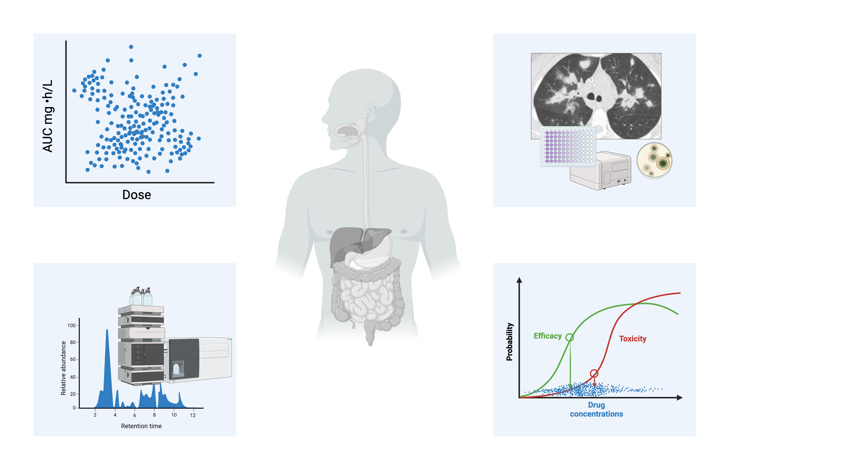
When does TDM have clinical utility?
Substantial PK variability
No other suitable surrogate dosing endpoints
Assay is available
Therapeutic range defined
Figure: R. Lewis. Created with biorender.com
Notes:
Reducd time to achieving therapeutic drug concentrations by 10 to 31 days

Slide 4
Early antifungal TDM Small case series, Toxicity-focused No antifungal susceptibility testing
AmB
5-FC
Ketoconazole,
miconazole
Itraconazole
1990s
1968
Drutz et al.¹
Bogaerts et al. Aspergillus prophylaxis³
Denning et al. Cryptococcal meningitis⁴
Denning et al Aspergillosis treatment⁵
BSAC Guidelines⁶
1980s
1977
Kaufmann & Frame²
Risk of treatment failure and breakthrough infections with
subtherapeutic itraconazole concentrations
¹ Drutz, D. J. et al. Rev. Infect. Dis. 9, 392–397 (1987)
² Kauffman, C. A. et al. Antimicrob. Agents Chemother. 11, 244–247 (1977)
³ Boogaerts, M. A., Mycoses, 1989 32 Suppl 1, 103-108.
⁴ Denning, D. W. et al. Am. J. Med., 86(6 Pt 2), 791-800.
⁵ Denning, D. W et al. Arch. Intern. Med. 149, 2301–2308 (1989)
⁶ British Society for Antimicrobial Chemotherapy Working Lancet 337, 1577–1580 (1991)

Slide 5
The ascendency of antifungal TDM Standardised antifungal susceptibility testing Maturation of PK/PD basis for antifungal dosing Guideline recommendations
RCT suggesting voriconazole treatment failure could be prevented with TDM
Voriconazole
Posaconazole
suspension
Posaconazole
tablets/IV
2013
2006
2012
2002
Park et al. Clin Infect Dis 2012⁹
2007
Walsh et al. Open-label Phase III Posaconazole targets⁷
Jang et al. FDA-defined exposure targets⁸
2005
Trifilio et al. Unpredictable PK in HSCT patients¹⁻³
Smith et al. Disease progression and toxicity³
Imhof et al. Neurological adverse effects⁴
Pascual et al. Voriconazole “therapeutic range”^{5,6}
1.Trifilio, S. et al. B. Bone Marrow Transplant. 35, 509–513 (2005). 2. Trifilio, S. et al. Cancer 109, 1532–1535 (2007) 3. Trifilio, S. et alBone Marrow Transplant. 40, 451–456 (2007)
4. Smith, J. et al. Antimicrob. Agents Chemother. 50, 1570–1572 (2006)
5. Imhof, Clin. Infect. Dis. 39, 743–746 (2004)
6. Pascual, A. et al.. Clin. Infect. Dis. 46, 201–211 (2008)
7. Walsh, T. J. et al. Clin. Infect. Dis. 44, 2–12 (2007) Clin. Pharmacol. Ther. 88, 115–119 (2010)
Notes:
On the contrary, in the TDM group, the attending physician could wait because adverse events were expected to be alleviated after dosage adjustment. However, the time delay between adverse events and drug discontinuation suggests that the attending physicians tried to continue voriconazole as long as they could (Figure 3).

Slide 6
Pragmatic TDM? Incorporation of PK/PD in drug development Increasing focus on role of TDM in patients with extreme PK variability (e.g., ICU) Management in refractory infections
SUBA-itracon.
Isavuconazole
Olorofim
Fosmanogepix
Others…
Rezafungin
Ibrexafungerp
2018
2023
2015
Veringa et al. J. Antimicrob. Agents
61, 106711 (2023)
2021

Slide 7
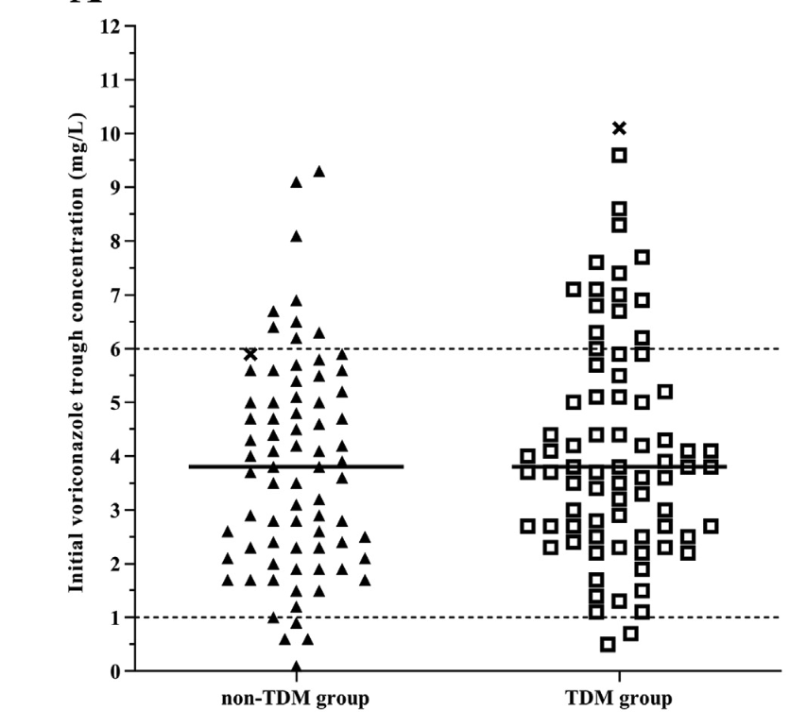
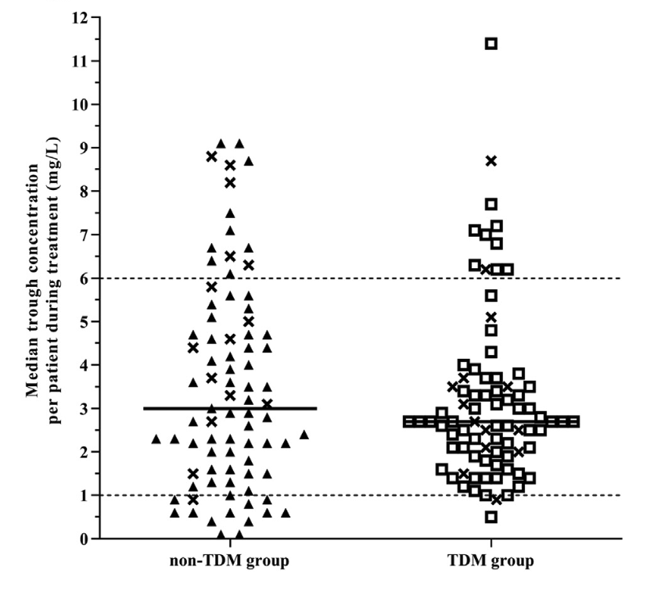
Can treatment failure be prevented with TDM?
90% of patients with 1° voriconazole treatment
Initial voriconazole level
Median voriconazole levels
Initial C_{min} TDM 3.9 v Non-TDM 3.8
High initial CRP concentrations?
Infrequent CYP2C19 HM and PM mutations?
Veringa, A. et al. Int. J. Antimicrob. Agents 61, 106711 (2023)

Slide 8
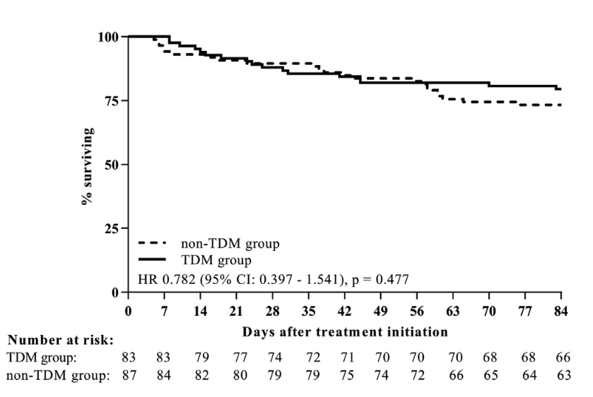
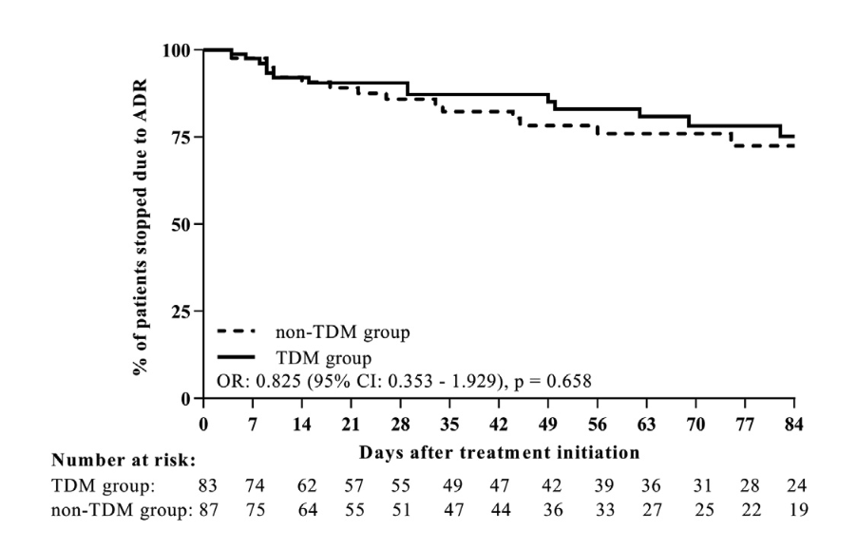
Can treatment failure be prevented by TDM?
12-week survival
Adverse reaction
Veringa, A. et al. Int. J. Antimicrob. Agents 61, 106711 (2023).

Slide 9
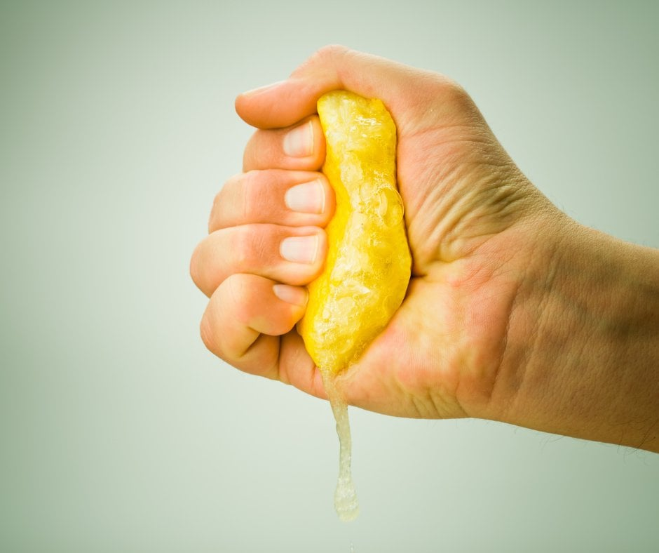
How much “juice” is left to squeeze from TDM?
Notes:
Paradox: Centres that have rapid TDM may show the least benefit because they do other thigs so well?

Slide 10
Which antifungals benefit from TDM? (with other agents added by speaker)
Amphotericin B (liposomal)
Not indicated, clinical target range still poorly defined
5-FC
Routinely recommended for patients with changing renal function
Fluconazole
Specific populations populations: CRRT ICU, Pediatrics, Sepsis, CNS infection
Itraconazole
Routinely recommended for all patient populations
Voriconazole
Posaconazole
Isavuconazole
Routinely recommended for all patient populations, prophylaxis and treatment
Specific populations: Alternative administration methods (enteral feeding), critically-ill, CRRT, extremes in weight, pediatrics, resistant infections
Routinely recommended for treatment, consider for prophylaxis
???
???
Investigational (Olorofim, Fosmanogepix, Oral-AmB…)
Ibrexafungerp?
Echinocandins (Anidulafungin, caspofungin, micafungin, rezafungin)
Critically-ill, obese, hypoalbuminemia, refractory/resistant infections?
McCreary, E. K. et al. Utility of Triazole Antifungal Therapeutic Drug Monitoring: Insights from the Society of Infectious Diseases Pharmacists: Endorsed by the Mycoses Study Group Education and Research Consortium. Pharmacotherapy 43, 1043–1050 (2023)

Slide 11
Voriconazole TDM Recommendations
Patients
Routinely, all patients, IV to oral switch
Timing
C_{min} Day#2 after loading dose, or day #5
without loading dose, follow-up with changes in clinical
status or medications change
Targets
Prophylaxis: ≥ 0.5 mg/L; Treatment: ≥ 1-2 mg/L
Some advocate 2-4 mg/L for severe infection
Toxicity: 4-5.5 mg/L
Adjustments
(50, 200 mg
tablets)
0-0.5 mg/L: increase dose by 50%
> 0.5 -< 1.0 mg/L: increase dose by 25%
> 5.5 mg/L but no AE: decrease dose by 25%
> 5.5 mg/L and AE: Hold dose and decrease subsequent dose by 50%
Make sure patient taking on empty stomach
NLME (Bayesian) Models-Fit for purpose?*
McCreary, E. K. et al.. Pharmacotherapy 43, 1043–1050 (2023)
NLME-Non-linear mixed effects
*Kluwe, F. et al. Clin. Pharmacokinet. 62, 1461–1477 (2023)

Slide 12
CYP2C19 genotyping?
CYP2C19 genotyping? ¹⁻³
Consider switch to alternative antifungal and CYP2C19 genotyping if subtherapeutic after 2 adjustments
If CYP 2C19 (*17/*17) ultrarapid metaboliser
Consider boosting strategies (omeprazole), TID dosing
Start at 1.5 times standard dose
Consider alternative antifungals
If CYP 2C19 (*2/*2, *2/*3, or *3/*3) poor metaboliser
Consider starting with 50% of standard dose if voriconazole deemed necessary
Use alternative antifungal not dependent on CYP2C19 metabolism
1. Chau, M. M. et al. 2021. Intern. Med. J. 51 Suppl 7, 37–66 (2021)
2. Morihyama et al. CPIC guidelines. Clin Pharmacol Ther 2017;102:45-516.
3. Dutch Pharmacogenetics Working Group. https://pharmgkb.org/

Slide 13
TDM-guided dosing of voriconazole is often suboptimal Precision dosing with a single trough?
Triazoles:
AUC/MIC PK/PD
fAUC/MIC target > 25
AUC₀₋₁₂
Cmin
C_{min} 1-4.5 mg/l correlated with an
AUC₀₋₂₄ 43-151 mg¹⁻³
Michaelis Mention constant
Velocity =(V_{max}· C)/(Km + C)
Reaction rate at full saturation
Voriconazole conc.
Notes:
Everyone knows what the ideal situation is, but the implementation is still so much challenging

Slide 14
Variable voriconazole clearance over target TDM ranges in adults
Parameterª | Mean | Median | 95% CI | SD | %CV^{b}
V_{max} (mg/h) | 35.397 | 30.069 | 25.533-41.278 | 20.845 | 58.889
K_{m} (mg/L) | 2.129 | 1.181 | 0.140-3.924 | 2.361 | 110.874
V (liters) | 45.407 | 44.933 | 25.205-66.183 | 22.091 | 50.436
Kcp (h⁻¹) | 3.308 | 0.948 | 0.461-2.494 | 7.320 | 221.251
Kpc (h⁻¹) | 1.447 | 0.262 | 0.169-0.346 | 4.109 | 284.065
ªV_{max} is the maximum rate of enzyme activity (mg/liter),K_{m}(mg/liter) is the concentration of voriconazole at which enzyme activity is half maximal; V is the volume of the central compartment (in liters); and kcp and kpc(h⁻¹) are the first-order intercompartmental rate constants. ^{b}CV%, percent coefficient of variation.
The change in Michaelis mention PK occurs within the targeted therapeutic range
The saturation point in patients is extremely variable (non-predictable)
K_{m}-V_{max} cannot be predicted a priori (even with genotype)-may be very different in an indiviudal patint with population mean
With a single trough the behavior of voriconazole appears inscrutable with excursions from low to high concentrations and vice versa without apparent reason
Hope W et al. Antimicrob Agents Chemother 2019; 63.

Slide 15
What type of TDM approach was needed to accurately characterize voriconazole K_{m}-V_{max}?
Observing the transition from linear to nonlinear PK,
which is triggered by dosage escalation or drug clearance over time
N=19 Allogeneic HSCT patients,
Predominately Caucasian
Some patients receiving similar amounts of drug have linear PK, while others have overtly nonlinear PK
4 timed
samples
4 timed
samples
Pop-PK
Model a priori
Bayes estimate
a posteriori
of Km-Vmax
and PK parameters
“Precision dosing
recommendation”
Hope W et al. Antimicrob Agent Chemother
2019; 63.
85.7% of patients achieved trough of 1-3 mg/L
Notes:
Study suggested variability is completely predictable and not a result of changes in PK secondary to physiological instability.

Slide 16
Voriconazole TDM to avoid toxicity?
Cause or effect?
1.0
Considerable uncertainty
1.0
0.8
0.8
0.6
0.6
Probability of treatment-related CNS AE
Probability of treatment-related hepatic AE
0.4
0.4
0.2
0.2
0.0
0.0
0
2
4
6
8
10
0
2
4
6
8
10
Voriconazole C_{min} (mg/L)
Voriconazole C_{min} (mg/L)
In phase II/III trials analysis voriconazole concentrations up to 10 mg/L² were-non discriminative for predicting predicting future liver toxicity (aROC=0.5 )- Ethnic differences- e.g., Asian vs. Caucasian?
1-Liu et al. Antimicrob Agents Chemother 2014; 58:4727–4736.
2-Tan et al. J Clin Pharmacol 2006; 46:235–243.

Slide 17
Should elevated voriconazole C_{min} be the sole trigger for dose reduction?
16/ 320 (5%) of patients with multiple
confounders and other possible causes
Dolton, M. J. et al. Antimicrob. Agents Chemother. 56, 4793–4799 (2012)
Park, W. B. et al. Clin. Infect. Dis. 55, 1080–1087 (2012)
Heo, S. T., et al. Clin. Microbiol. Infect. 23, 387–390 (2017)
Kim, S.-H. et al. Int. J. Infect. Dis. 15, e753–8 (2011)
Notes:
Clinical scenario

Slide 18
Posaconazole TDM Recommendations Use DR tablet, DR suspension > oral suspension
Patients
Routinely, all patients with oral suspension,
Routinely DR tablet/DR suspension or IV during treatment; Consider for prophylaxis
Timing
C_{min} Day #3-5 with loading dose, 7 days without loading dose
Targets
Prophylaxis: ≥ 0.5-0.7 mg/L; Treatment: ≥ 1-1.5 mg/L
Toxicity: >3-3.75 mg/L
Adjustments
(100 tablet, IV)
100 mg tablet, IV, DR suspension
Linear-dose adjustments, consider q12h dosing for very low C_{min}
NLME models more fit for purpose¹
McCreary, E. K. et al.
Pharmacotherapy 43, 1043–1050 (2023)

Slide 19
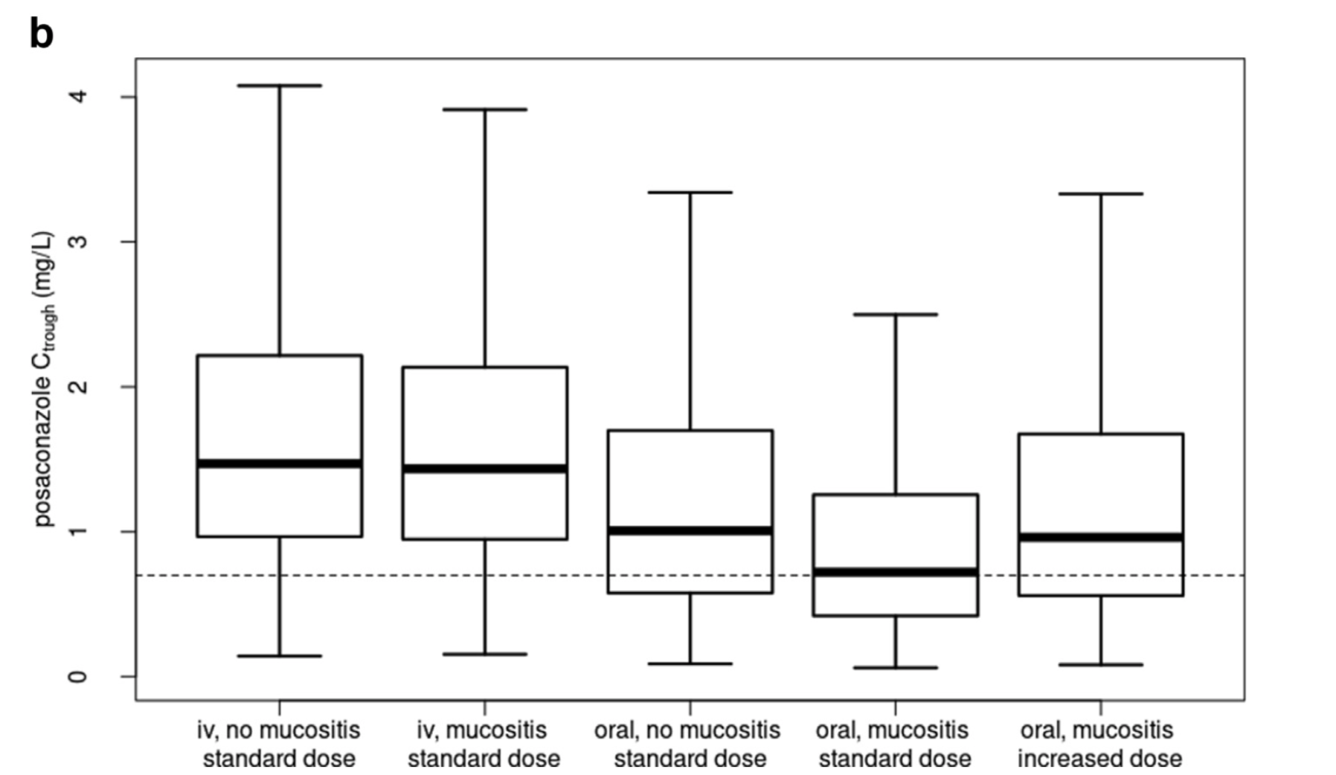
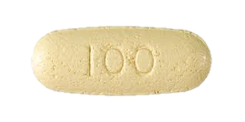
Conditions that strongly favour TDM with DR tablets?
Poor appetite, not taken with food
Concomitant acid suppression therapy
Obesity
Refractory/resistant infections
Toxicity (e.g., pseudohyperaldosteronism, hepatic injury)
Crushed DR tabs with enteral feeding tubes
Toxicity or breakthrough infections
Severe diarrhea/intestinal mucositis
400 mg BID day #1, then 400 mg twice daily¹
67.6% vs. 51.4%
bioavailability
McCreary, E. K. et al.
Pharmacotherapy 43, 1043–1050 (2023)
¹Jansen, A. M. E (2022). Et al. Clin Microbiol Infect, 28(7), 1003-1009.

Slide 20
No exposure-response relationship with posaconazole DR tablets?
Global clinical response at week 6 by quartile of within-participant mean posaconazole plasma C_{min}
Maertens, J. A. et al. Clin Drug Investig, 43(9), 681-690.

Slide 21
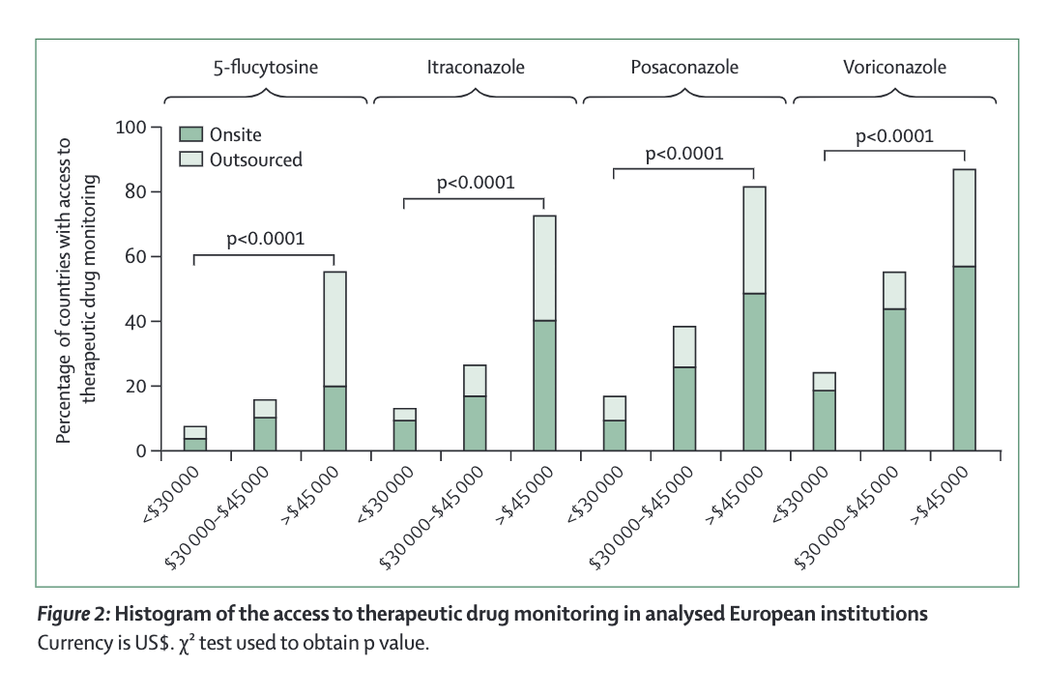
TDM is not widely available across EU ECMM survey of Antifungal access, susceptibility testing and TDM strongly linked to GDP
Similar patterns seen in surveys of Asian-Pacific countries
Salmanton-García, J. et al. Int. J. Antimicrob. Agents 61, 106718 (2023)

Slide 22
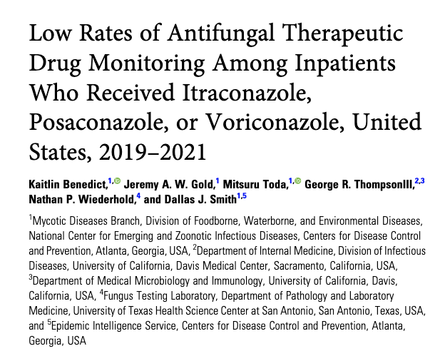
…and infrequently performed in the United States ECMM survey of Antifungal access, susceptibility testing and TDM strongly linked to GDP
Only performed
in 15.8% of eligible patients
Specialist populations: Less frequently performed during prophylaxis, long turn-around times, insurance coverage?
Benedict, K et al. Open Forum Infect Dis, 10(9), ofad468
Benedict, K. et al. (2023). Open Forum Infect Dis, 10(8), ofad389
Notes:
Luxury rather than necessity? When TDM is not part of the package labeling it is sometimes difficult to receive resources and reimbursement for testing.

Slide 23
What is needed- Advances in analytical approaches More high-risk patients outside the hospital FDA Project “Optimus” in Oncology- bigger focus on TDM
Dried blood spot
Saliva
Volumetric absorptive microsampling devices
Soenen, R. et al. Promising Tools to Facilitate the Implementation of TDM of Biologics in Clinical Practice. J. Clin. Med. Res. 11, (2022)

Slide 24
Summary
TDM still represents the most direct method for detecting subtherapeutic or supratherapeutic exposures
TDM plays a critical role for doing guidance in populations with extreme PK variability, resistant pathogens, treatment failure…
However, much of real-life TDM practice is still not true precision dosing
Empiric linear dosage adjustments
No Model-informed precision dosing based on covariates and genotypes
No incorporation of biomarkers or MIC targets
How will new antifungal change TDM?
Newer, rapid POC testing that can be more readily applied in outpatient settings is needed and will be a focus of future biologics and oncologic agents

