Slide 1
Navigating the Maze: Antifungal drug interactions in the era of targeted cancer therapy
Il Monitoraggio Terapeutico Del Farmaco (TDM)
Roma 01 Aprile 2020
Russell E. Lewis
Associate Professor of Infectious Diseases
Department of Molecular Medicine
University of Padova
Notes:
Good morning. I would like to thank Proff.ssa Goffredo for the invitation to speak at this interesting congress.

Slide 2
Disclosures
Royalities: UptoDate
Research support: Merck & Co, Inc., Gilead Inc.
Speaking fees: Pfizer, Avir, F2G, Gilead, Cidara
Advisory: Basilea, Gilead, F2G
Notes:
These are my disclosures

Slide 3
Invasive fungal diseases complicate the treatment of haematological malignancies
High incidence Candida and Aspergillus infections afflict between 5-25% of patients with prolonged neutropenia or during immunosuppressive therapy after haematopoietic stem cell transplantations. Infections caused by more resistant fungal pathogens are increasing
Delayed diagnosis Non-specific clinical presentation and diagnostic challenges frequently lead to delayed or missed diagnosis, contributing to poorer prognosis and higher mortality
High infection-related mortality A major cause of infection-related death with mortality rates approaching and sometimes exceeding 30%
Increased risk of malignancy relapse Fungal infections interrupt timing of chemotherapy needed to maintain remission or timing of haematopoietic stem cell transplantation
Notes:
Why the focus on antifungal drug interactions? Because invasive fungal infections are a major problem. The next speaker will address this topic in more detail, but it is worth emphasizing that fungal infections, particularly invasive candidiasis and invasive aspergillosis continues to be a frequent problem in high risk populations such as those undergoing treatment for hematological malignancies afflicting between 5-25% of patients. And infections due to more resistant fungal pathogens such as C. auris and Mucorales are increasing.
Although the diagnostic capabilities have improved over the last 20 years, the sensitivity of tests is reduced by antifungal prophylaxis and delayed diagnosis remains a problem and contributes to the relatively high infection-related mortality.
What sometimes is not appreciated is how a diagnosis or presumptive diagnosis of fungal infection impacts the timing of chemotherapy needed to maintain remission or eligibility for transplantation or en rollment in clinical trials, therefore fungal infections incrase the risk of malignancy relapse and impact the treatment of the underlying disease

Slide 4
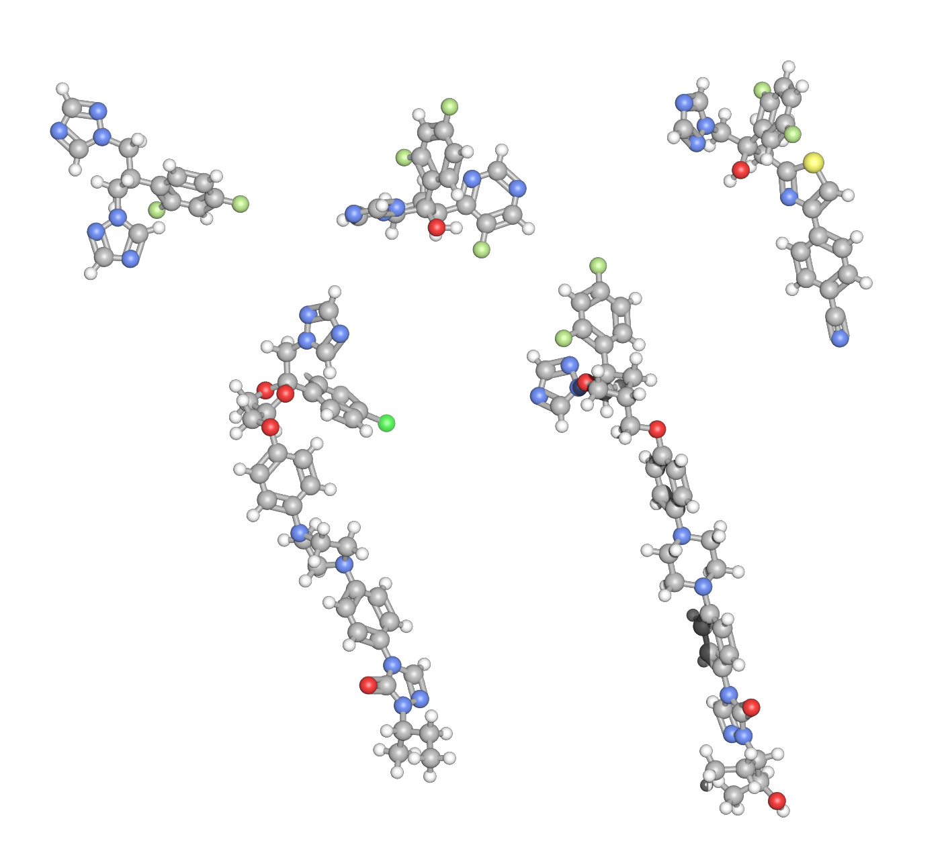
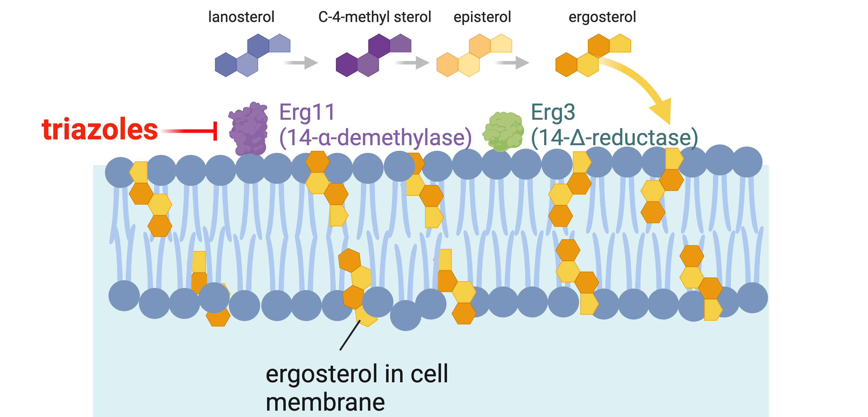
Triazole antifungals are essential drugs for preventing and treating invasive fungal diseases
voriconazole
fluconazole
isavuconazole
Heme-binding
pocket
itraconazole
posaconazole
Triazole
Fungal lanosterol demethylase (14-α-demethylase)
Triazole ring
Notes:
Triazole antifungals are the most frequently prescribed class of antifungals used to prevent and treatment invasive fungal diseases. Fluconazole for yeast infections, and voriconazole, posaconazole and isavuconazole are broader-spectrum agents with coverage against both Candida and Aspergillus species. Triazole antifungals exert their antifungal effects by binding to a heme-containing pocket in the fungal enzyme 14—alpha-demethylase, which is a cytochrome P450 dependent enzyme that catalyzes the rate-limiting step of ergosterol production. By binding to this pocket, the enzxyme cannot interact with lanosterol, and the fungal cell membrane accumulated toxic sterol intermediates. that impair the fluidity and function of the cell membrane

Slide 5
CYP3A4/5-mediated drug interactions are a major “off target” effect of broad-spectrum triazoles
Human cytochrome
P450 3A4
Fungal CYP51A
(lanosterol demethylase)
Antifungal (mean t½ ) | Inhibition strength | Antifungal spectrum
Fluconazole (30h) | ++ (competitive) | +
Itraconazole (30-40h) | +++ (irreversible) | ++
Voriconazole (6h) | +++ (irreversible) | ++
Posaconazole (26-35) | +++ (irreversible) | +++
Isavuconazole (130h) | ++ (competitive) | +++
An analysis of 6952 patients records from 150 hospitals detected drug interactions (DDIs) in 86%–93% of patients receiving mould-active triazoles, with more than one-quarter of the interaction classified as ‘contraindicated’ combinations
Andes D et al. Antimicrob Agents Chemother. 2016;60:3398-3406.
Lewis, R. et al. J Antimicrob Chemother, 2024:79(6), 1203-1217.
Brüggemann RJ et al. The Lancet Haematology. 2022;9:e58-e72.
Notes:
The problem is that this fungal cytochrome P450 enzyme has substantial homology with human cytochrome P450 enzymes including CYP3A4. In general, the broader spectrum triazole exhibit non-competitive (irreversible binding) to human CYP3A4, although and interesting exception is isavuconazole, which has a binding affinity more similar to fluconazole but a much longer half-life.
So it is not a surprise that drug-interactions with triazoles are a common problem. Indeed, in an analysis of prescribing database of nearly 7000 patients records that involved triazole prescripotions, DDIs were identified in beween 86-93% of patients who received mould-active triazoles, and more than one quarter of the interactions were classified as ”major” or ”severe”
the recovery time after removing the recovery time after removing mechanism-based inhibitors typically is reported as 20–50 h, while recovery after removing enzyme inducers takes around 40–60 h. This suggests that more than 90% of CYP P450 recovery can occur within 10 days after stopping mechanism-based inhibitors and with- in 14 days after stopping inducers. Mechanism-based inhibitors typically is reported as 20–50 h, while recovery after removing enzyme inducers takes around 40–60 h. This suggests that more than 90% of CYP P450 recovery can occur within 10 days after stopping mechanism-based inhibitors and with- in 14 days after stopping inducers.

Slide 6
Multiple factors affect the severity and duration of triazole drug interactions
Brüggemann RJ et al. Lancet Haematology. 2022;9:e58-e72.
Lewis, R. et al. J Antimicrob Chemother, 2024:79(6), 1203-1217.
PgP-P glycoprotein; OATP-Organic anion Transporter Protein
Notes:
The severity and nature of drug-drug interactions is not entirely dependent on the triazole and victim drug, but also other factors including other drug therapies, the inflammatory state, patient genetics and coexisting medications.
What makes triazole drug interactions particularly dangerous in hematology populations, however, is the fact that these interactions generally involve high magnitude interactions of low therapeutic drugs such as immunosuppressant agents or chemotherapy- therefore nearly all interactions fall in the yellow or red categories

Slide 7
The prevalence of drug interactions reported in cancer patients is increasing Analysis of trends in drug interaction publications 1995-2022
Range of “major” interactions: 5.97%- 67.3%;
More recent studies reported higher percentages of major interactions
Bibi et al.
Mateti et al.
Ismail et al.
Turossi-Amorim et al
Popa et al.
Monterio et al.
Muhammed Umar et al.
Prevalence in identified drug interactions
Tavakoli-Ardakani et al.
van Leeuwen et al.
Mouzon et al.
Vecchia et al.
Lemachetti et al.
Crul et al.
Ramos-Esquivel et al
Year of publication

Slide 8
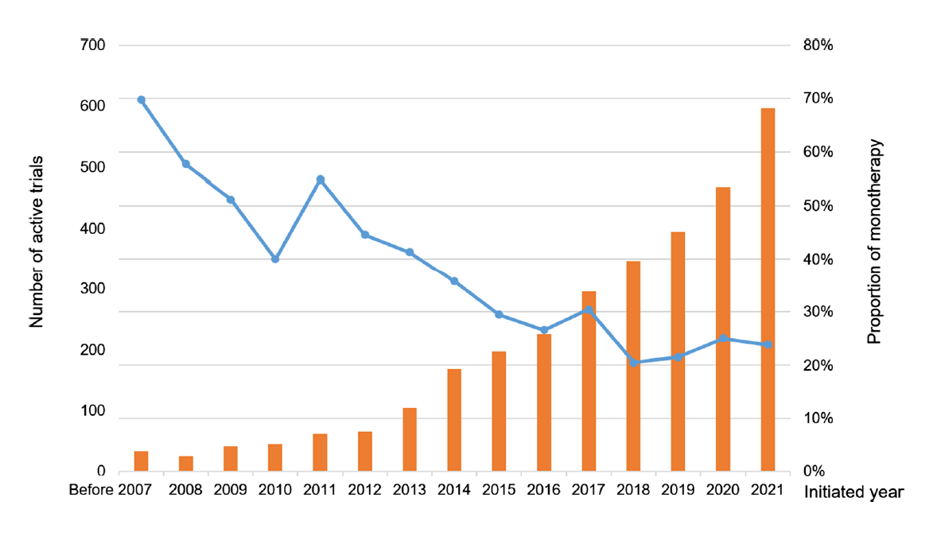
Number of targeted oncologic therapy trials registered in clinicaltrials.gov
Enabled by advances in:
Genome sequencing-HT NGS
Tyrosine kinase inhibitors
CRISPR-Cas9 and gene editing
Proteomics and biomarker discovery
CAR-T cell therapy
Trials
Monotherapy trials
Many agents are now approved earlier in the cycle of evidence generation
(such as expansion cohorts of phase I trials)
“Real-world evidence now provides a better understanding of chronic safety
and long-term efficacy of oncology drugs used in the clinic”
Blumenthal GM et al. Oncologist 2017;22:762-7.
Notes:
58% of new therapies in Phase I-III clinical trials have relative or absolute contraindications for triazole prophylaxis of CYP 3A4, QTc prolongation), ngs- next generation sequencing

Slide 9
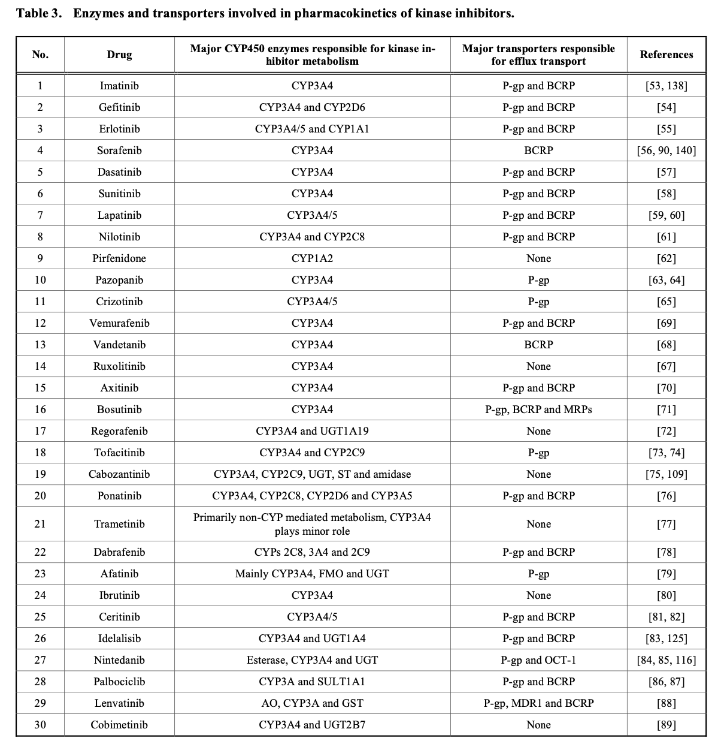
The first 30 small molecule kinase inhibitors for treatment of cancer approved by the US FDA from 2001-2015 28/30 (93%) were metabolized via CYP P450 3A4/5
O’Brien, AZ Moghaddam, M.F. Curr Med Chem. 2017;24:3159-84.

Slide 10
12 new agents with AML indications since 2017 (FDA)
FLT3 Inhibitors – midostaurin, gilteritinib, quizartinib
IDH1 inhibitors – ivosidenib, olutasidenib
IDH2 Inhibitor – enasidenib*
BCL2 inhibitor - venetoclax
Antibody-drug conjugate - gemtuzumab ozogamicin
Oral HMA – azacytidine
Liposomal cytarabine-daunorubicin - CPX351
Hedgehog inhibitor – glasdegib
Menin inhibitor- revumenib
Dilemma: How can these life-saving drugs be used safely with triazoles in a population of patients at high risk for invasive fungal disease?
FLT3 - tyrosine Fms-like tyrosine kinase 3
IDH1 -isocitrate dehydrogenase 1
IDH2 -isocitrate dehydrogenase 2
BCL-2 - broad-spectrum B cell lymphoma 2
HMA – Hypomethylating agents
NPM1, KMT2A- menin production
*only “ib” drug not metabolized through CYP3A4

Slide 11
Some interactions are complex FLT3-inhibitor midostaurin
CYP3A4
CYP3A4
CPG6221
(O-demethylation)
t½ 32.3h
midostaurin
t½ 20.5h
CPG52421
(7-hydroxylation)
t½ 482h
30
CPG52421
25
High inter- and intra-patient pharmacokinetic variability with variations in the degree of FLT3 inhibition with recommended dosing
20
Plasma trough level μM
15
10
CPG6221
5
midostaurin
0
0
20
40
60
80
100
120
140
160
Levis et al. Blood 2006;108(10):3477–83
Study day
Notes:
FLT3 (FMS-like tyrosine kinase 3) is a gene that encodes a type of receptor tyrosine kinase, which is involved in the regulation of hematopoiesis (the formation of blood cellular components). FLT3 plays a critical role in the survival, proliferation, and differentiation of hematopoietic stem cells and progenitor cells. **Mutations in FLT3**:
- nternal Tandem Duplication (ITD)**: This is the most common type of FLT3 mutation in AML. It involves the duplication of a portion of the FLT3 gene, leading to constitutive activation of the FLT3 protein.
- Tyrosine Kinase Domain (TKD) Mutations**: These are point mutations that occur in the tyrosine kinase domain of the FLT3 gene, also resulting in constitutive activation.

Slide 12
Midostaurin + triazoles Experience from clinical trials
Pulmonary toxicity, including fatal events were reported in early trials → associated with excessive midostaurin exposures related to CYP3A4 inhibitors
Thereafter, administration of triazoles was suspended and negative chest xray was required for enrollment → no further fatal pulmonary events
In an analysis of the RATIFY trial, co-administration of CYP3A4 inhibitors was associated with:
1.44 fold ↑ midostaurin plasma exposure (esp. in first week)
Accelerated time to grade III/IV adverse effects
Patients with a 50% decrease in midostaurin dose intensity had a > 2-fold increase in the hazard of experiencing an EFS event (relapse) while on treatment and a 73% increase in the hazard of death
Schlenk et al. suggested dose reduction to 25 mg every other day was safe during maintenance phase with a strong CYP3A4 inhibitor
SPC Recommendation: Avoid triazoles if possible or carefully monitor for toxicities
Ouatas T et al. 59° ASH 2017, abstract 3814
Stemler J et al. Ann. Hematol. 2020; 99:1429–1440.
Schlenk RF, et al. Blood 2019; 133: 840–51.

Slide 13
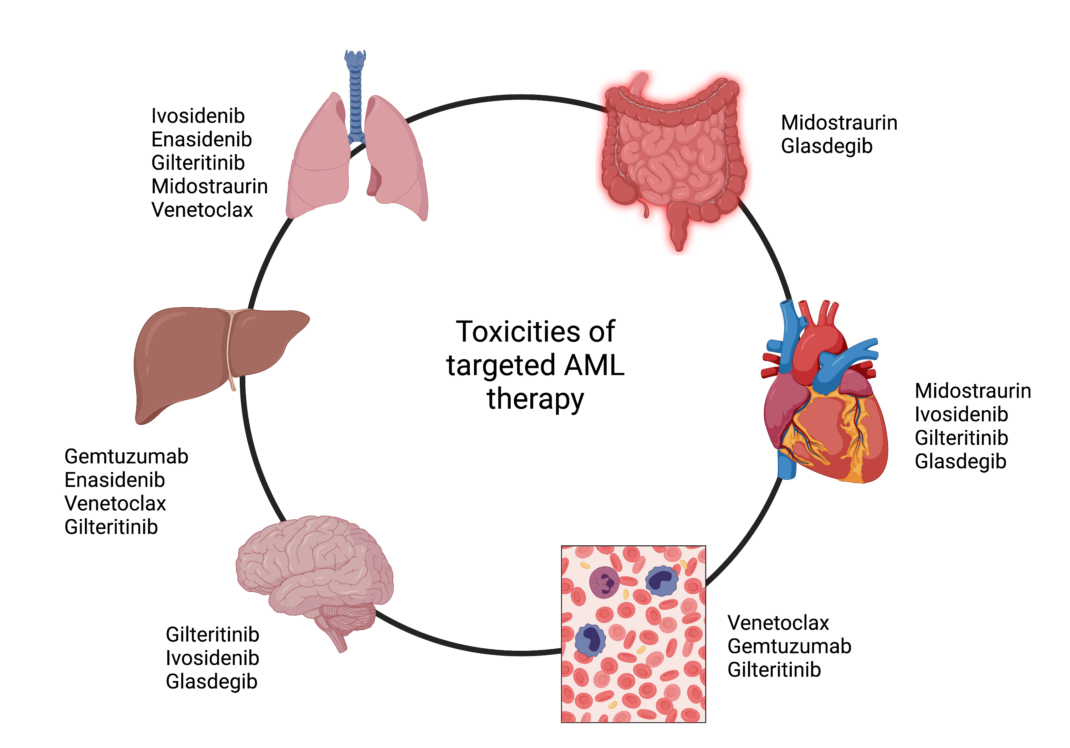
Toxicities are non-specific and overlap with common clinical syndromes
Wang ES and Baron J. Hematology Am Soc Hematol Educ Program 2020; 2020:57–66.

Slide 14
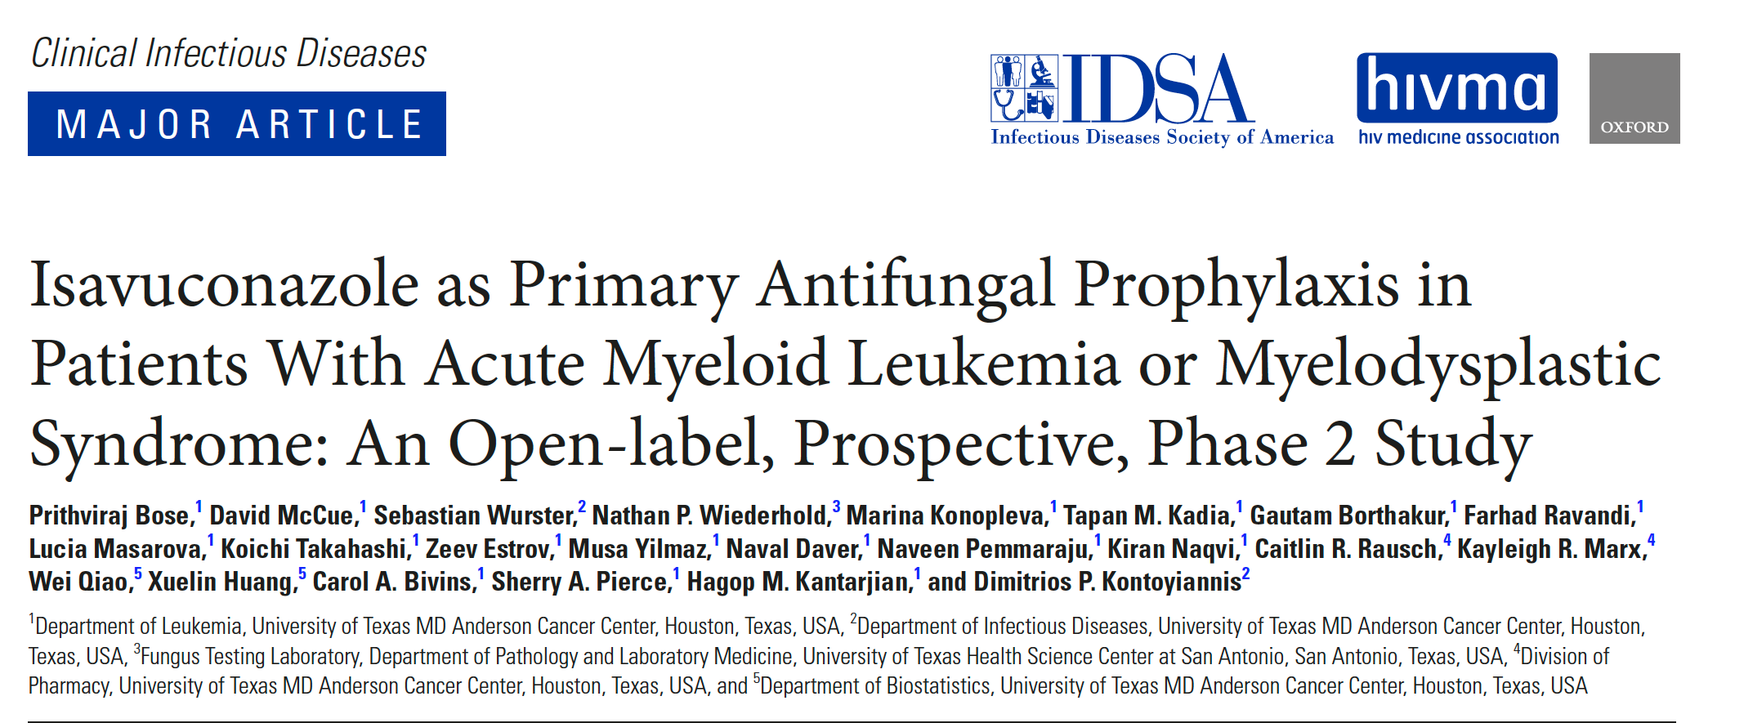
Isavuconazole prophylaxis is better tolerated than posaconazole during induction therapy with molecularly-targeted agents
Isavuconazole:¹
Grade 1 transaminitis 2.7%
Grade 2 elevated T. bili [2.9 mg/dL], 1.3%
No elevation of QTc at baseline vs. 10 days
Posaconazole:²
Grade III/IV liver injury 19%
Primarily hyperbilirubinemia
Higher frequency at serum levels >1,830 ng/ml.
¹ Bose P, et al. Clin Infect Dis 2021; 72:1755–1763.
² Tverdek FP et al. Antimicrob Agents Chemother 2017; 61.

Slide 15
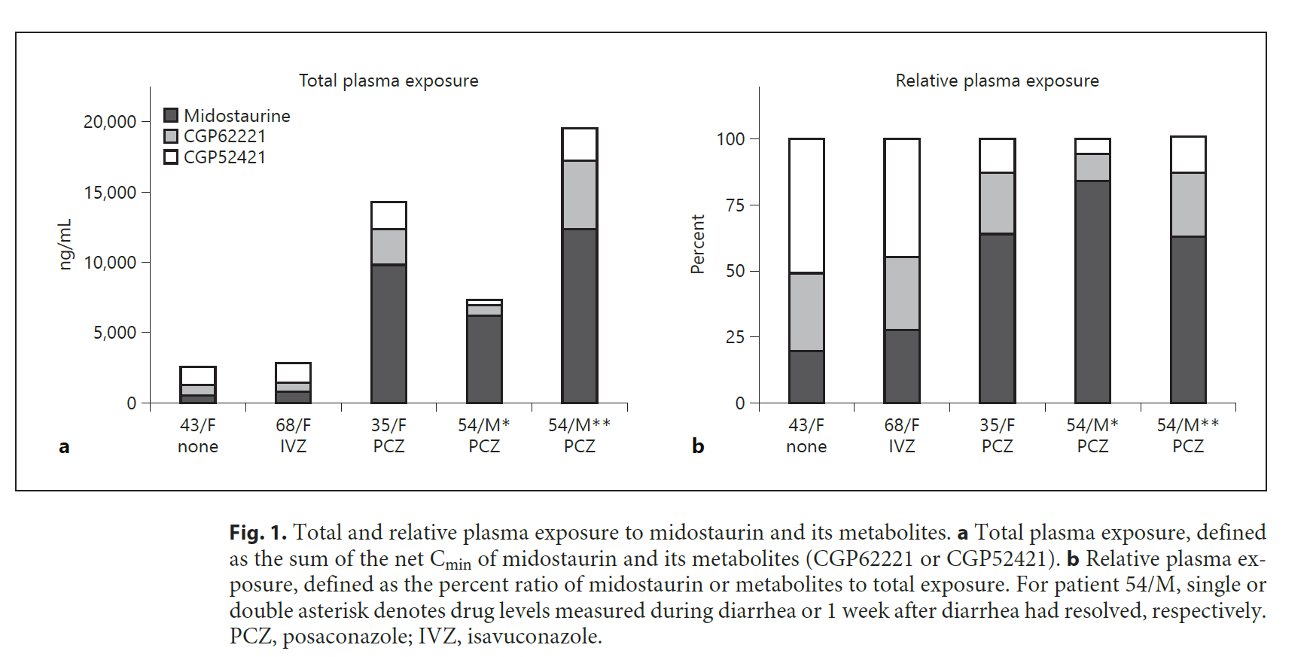
TDM for FLT3 inhibitors: Evidence that isavuconazole a better option?
Menna P. et al. Chemotherapy 2021; 66:47–52.

Slide 16
Do pharmacodynamic biomarkers have a role in addition to TDM to guide FLT3 dosing?
Measurable residual disease (MRD) monitoring: Flow cytometry or NGS on bone marrow
Resistance mutation monitoring: NGS on bone marrow or peripheral blood (e.g., F691L mutation)
Pharmacodynamic biomarkers: Measure direct biological effect of FLT3 inhibitor therapy on target pathway in leukemia cells
Phospho-flow cytometry to measure the phosphorylation level of FLT3 (pFLT3) or downstream signaling proteins (like pSTAT5)
Direct measurement of FLT3 ligand levels in plasma- can change with disease burden and response

Slide 17
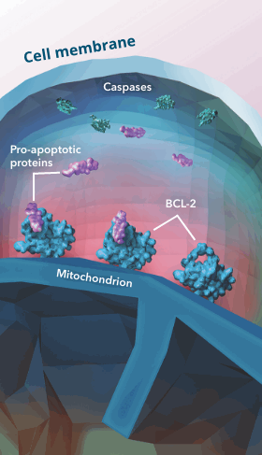
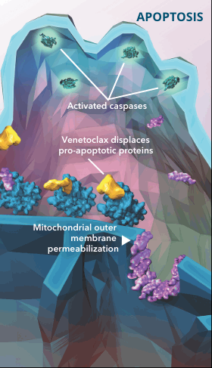
Venetoclax A transformational therapy that has led to dramatic improvements in outcomes for older and less-fit patients
Venetoclax is metabolised
by CYP3A4
Overexpressed BCL-2 allows hematologic cancer cells to evade apoptosis by sequestering pro-apoptotic proteins.
Venetoclax selectively binds to BCL-2, displacing pro-apoptotic proteins and triggering events that lead to apoptosis
Source: AbbVie

Slide 18
Venetoclax dose-adjusted ramp-up schemes in AML in patients receiving triazoles Posaconazole increases venetoclax AUC_{0–24} 8.8-fold¹
Day | Venetoclax dosing in combination with decitabine or azacitadine* |  |  | Venetoclax dosing in combination with low-dose cytarabine
 | Full dose (no interactions) | Moderateª CYP3A4 inhibitor | Strong^{b} CYP3A4 inhibitor | Full dose (no interactions) | Moderateª CYP3A4 inhibitor | Strong^{b} CYP 3A4 inhibitor
Day 1 | 100 mg | 50 mg | 10 mg | 100 mg | 50 mg | 10 mg
Day 2 | 200 mg | 100 mg | 20 mg | 200 mg | 100 mg | 20 mg
Day 3 | 400 mg | 200 mg | 50 mg | 400 mg | 200 mg | 50 mg
Day 4–28 | 400 mg | 200 mg | 70 mg | 600 mg | 300 mg | 70 mg
ª Includes fluconazole, isavuconazole; ^{b} Includes posaconazole, voriconazole;
^{c} 70 mg dose requires 7x10 mg tablets or 1x50 mg tablet + 2x10 mg tablets. AUC_{0–24}, Area under curve over 24 hours.
Agarwal SK, et al. Clin Ther 2017; 39:359–367;

Slide 19
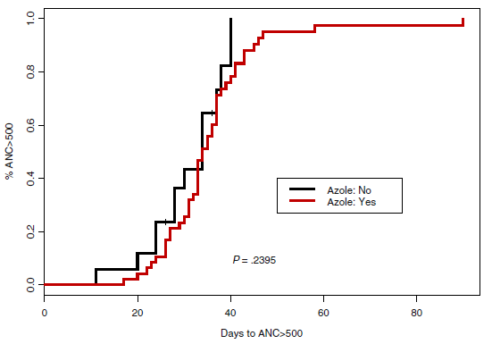
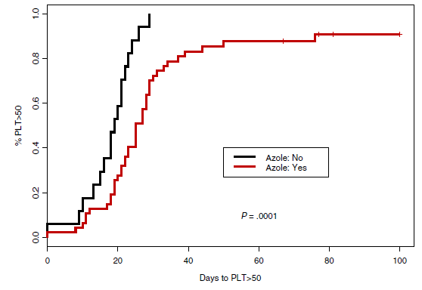
Is recommended dosing adjustment guidance for venetoclax sufficient? Retrospective analysis of time to ANC and PLT recovery in 64 patients with newly diagnosed AML who achieved a response after 1 cycle of Ven+HMA
Time to ANC recovery (>500 cells/mm³)
Daily venetoclax dose: 400 mg without concomitant azole antifungal, 200 mg with isavuconazole/fluconazole (moderate CYP3A4 inhibitors), or 100 mg with posaconazole/voriconazole (strong CYP3A4 inhibitors)
Time to platelet count recovery (>50,000 cells/mm³)
ANC, absolute neutrophil count; HMA, hypomethylating agent; PLT, platelet; Ven, venetoclax. Rausch CR, et al. Cancer 2021; 127:2489–2499.

Slide 20
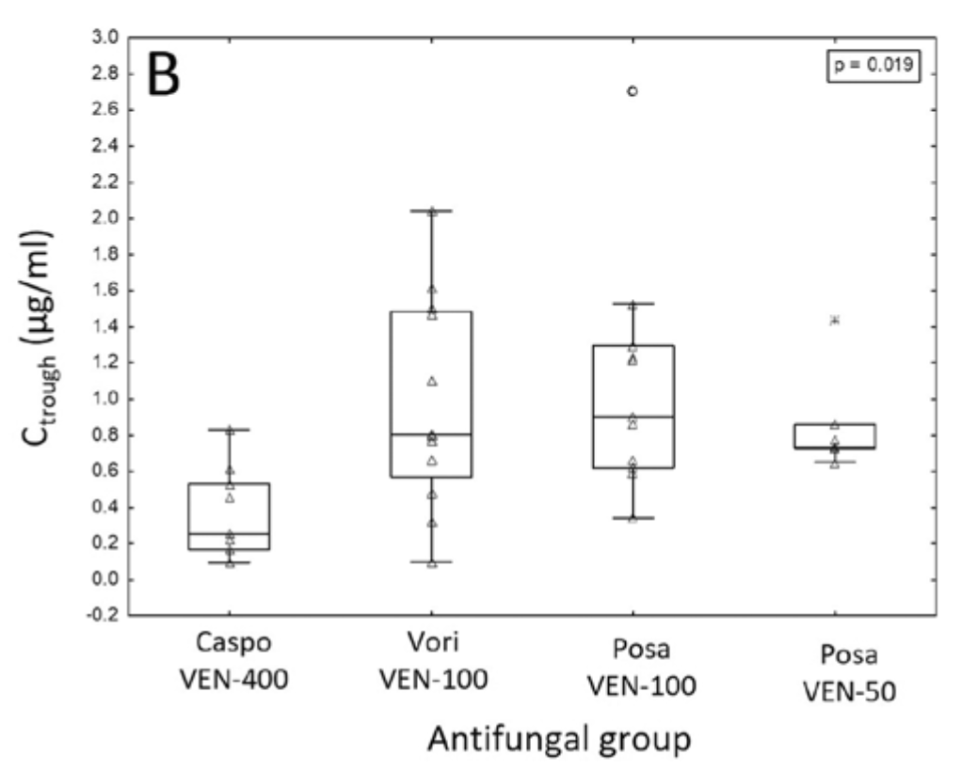
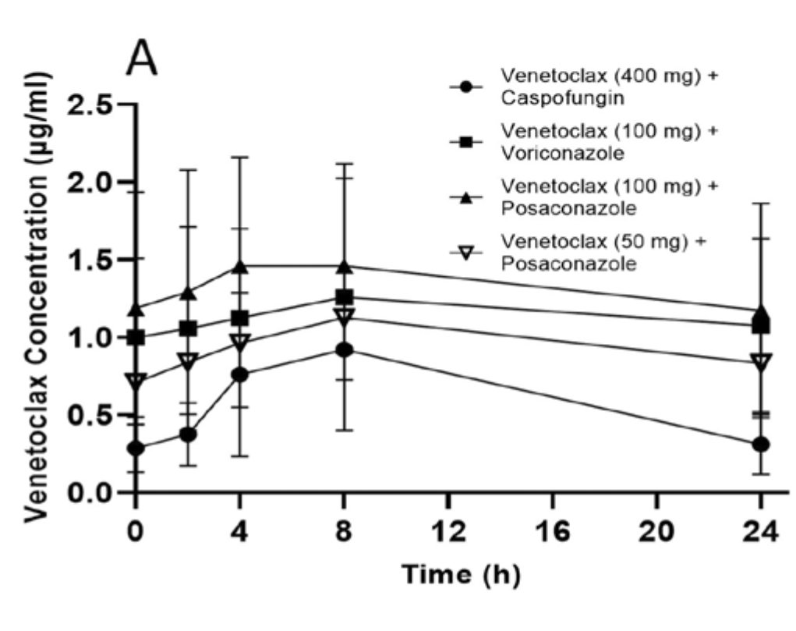
Prospective pharmacokinetic evaluation of venetoclax in AML supports re-­ evaluation of recommended dose adjustments with triazole antifungals
No patient with a C_{trough} > 0.85 μg/mL achieved ANC recovery by day 28 of cycle 2, and only 1 achieved PLT recovery by this time.
“Based on our modeling, we hypothesize the impact on myelosuppression is more significant during consolidation as a result of reduced VEN clearance by strong CYP3A4i, leading to accumulation and prolonged VEN exposure.”
Kawedia JD, et al. Am J Hematol 2025;100(4):740-743.

Slide 21
Minimal residual disease: Flow cytometry or NGS on bone marrow
BH3 profiling: assesses the mitochondrial response to various pro-apoptotic BH3 peptides- how “close” cells are to apoptosis
Apoptosis markers in leukemic cells: Annexin-V staining, cleaved Caspase-3
Proximity ligation assays: BIM release from BCL-2
Monitoring plasma levels of BCL-2 family proteins (BCL-2, MCL-1, BCL-XL, BIM)- underdosing vs. resistance?
Do pharmacodynamic biomarkers have a role in addition to TDM to guide venetoclax dosing?

Slide 22
TDM and dosing targets are established for antifungals at the population level
Antifungal | How was dosing established? | Preclinical efficacy PK/PD target | Clinical PK/PD efficacy target | Comments
AMB | Trial and error, maximum tolerated doses, test doses | Cmax/MIC 10 | Clinical target undefined | Dosing limited by toxicity. Optimal dose approach still debated
Liposomal AMB | Empirically to achieve similar efficacy of AMB with less nephrotoxicity | Cmax/MIC, AUC/MIC | Clinical target undefined | Optimal dosing approach still investigated, potential for less frequent higher-dose regimens (leishmanaisis, cryptococcal meningitis)
Flucytosine | Maintain concentrations above MIC, reduce high peak conc. associated with myelotoxicity | % T>MIC | 20-45% T>MIC; Cmax < 100 mg/L (toxicity) | Modest efficacy and rapid development of resistance. TDM not used in recent pivitol studies
Fluconazole | Maintain concentrations above MIC | AUC/MIC | AUC/MIC 25–100, Cmin 10-15 mg/L | Commonly underdosed in critically-ill patients (33%)
Voriconazole | Maintain concentrations above MIC | AUC/MIC | fAUC/MIC 25–50; Cmin > 1 (efficacy); Cmin < 6 (toxicity) | Highly variable PK, challenging dosing adjustments even with TDM
Posaconazole | Maintain concentrations above MIC | AUC/MIC | fAUC/MIC 25–50; Cmin > 0.7 (prophylaxis); Cmin > 1 (treatment) | Initially dosing limited by bioavailability. Efficacy versus toxicity risk of higher exposures poorly defined
Isavuconazole | Target AUC/MIC | AUC/MIC | fAUC/MIC 25–50; Clinical target undefined: Toxicity > 5.86 mg/L | Majority of patients achieve clinical PK/PD target for efficacy
Echinocandins (caspofungin, micafungin, anidulafungin) | Maintain concentrations above MIC | AUC/MIC | AUC/MIC 450-1185 AUC/MIC >3000 | Dosing not optimized for PD, inadequate PK exposures in obese and for isolates near susceptibility breakpoint
P-1742. Isavuconazole Therapeutic Drug Monitoring and Association with Adverse Events. IDWEEK 2025.

Slide 23
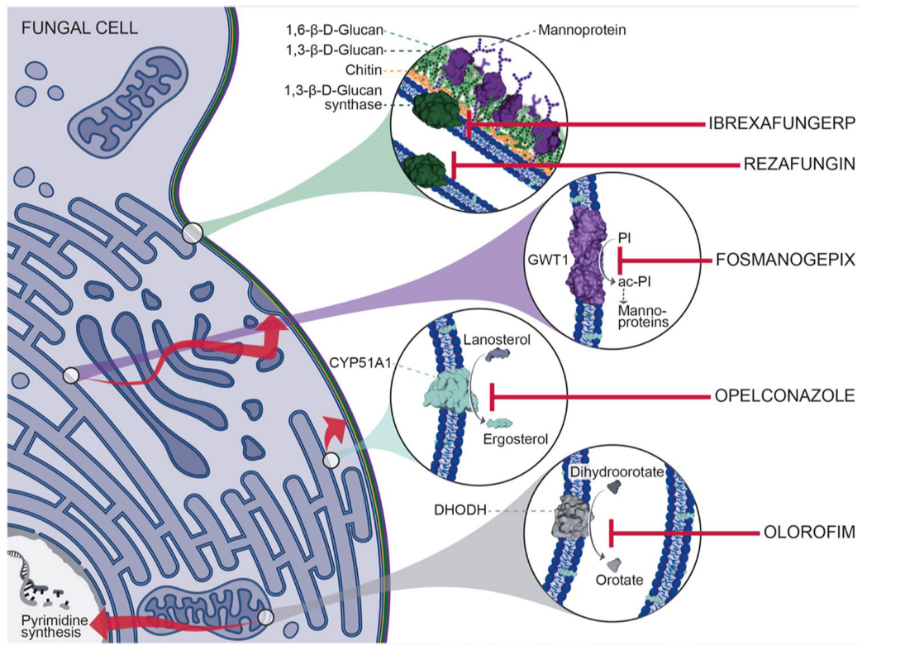
Newer antifungals on the horizon with fewer drug drug interactions Tetrazoles (> 100-1000 fold higher selectivity for fungal CYP51A): Oteseconazole (t_{1/2} =138 days) VT-1129 VT-1598 Inhalational triazole: Opelconazole
(t_{1/2} =130 hours)
inhalational
(No activity against yeast)
DHODH, dihydroorotate dehydrogenase; GWT1, glycosylphosphatidylinositol-anchored wall transfer protein 1; PI, phosphatidylinositol. Hoenigl M et al. Drugs 2021;81:1703–1729.

Slide 24
Why aren’t we dosing precision therapies precisely?
Individualized dosing adjustments
with triazoles and other strong
CYP3A4/5 inhibitors?
https://www.fda.gov/about-fda/oncology-center-excellence/project-optimus

Slide 25
Take home messages
Prophylaxis and treatment with triazole antifungals are mainstays for improving survival in patients at risk for invasive fungal diseases
The prevalence of drug interactions with triazole antifungals, including severe reactions, is increasing due to an explosion in targeted chemotherapies
Co-administration of triazoles with targeted chemotherapies, creates complex management decisions, especially in the setting of severe toxicities
Increasing evidence points towards a need for TDM-based dosing adjustments of targeted therapies when used with triazoles
Expansion for use of TDM, PD biomarkers, Bayesian MAP-model informed dosing, Ai?
Need for future effective, oral, outpatient antifungal therapy with no CYP3A4 interactions

