Slide 1
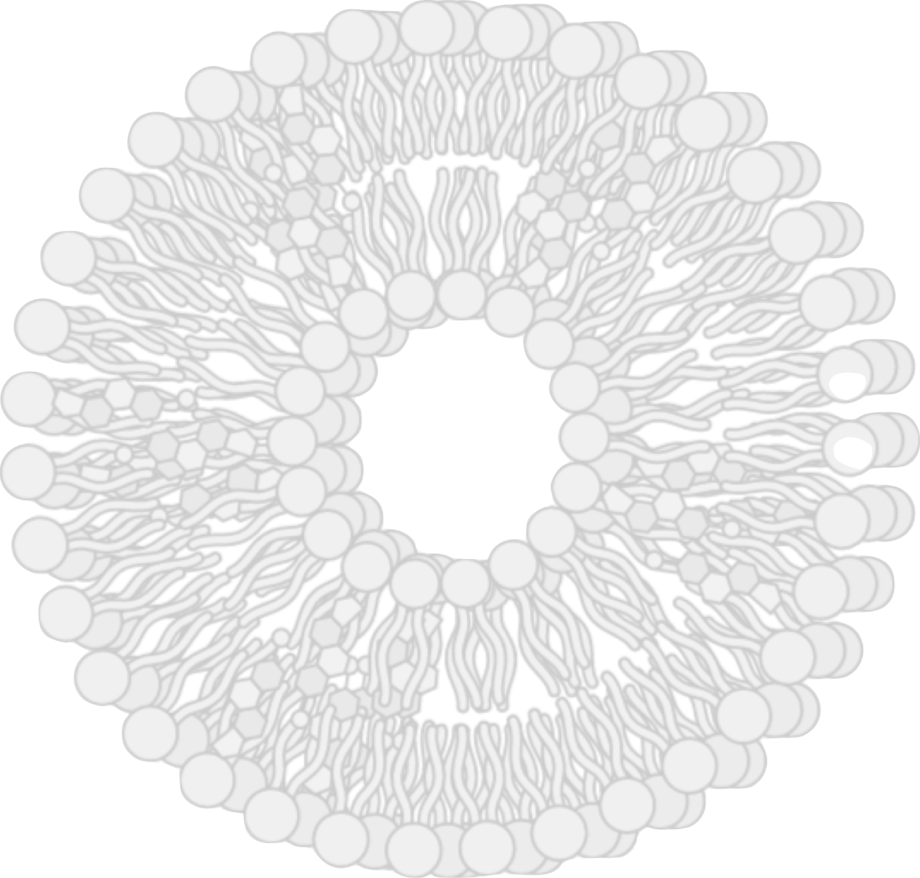
The importance of nanomedicine in drug delivery
Russell E. Lewis
Associate Professor of Medicine, Infectious Diseases (MED/17)
Dipartimento di Medicina Molecolare (DMM)
IHQ-AMB-0943 | Date of preparation: March 2023

Slide 2
Disclosures
Research support: Merck & Co.
Advisor fees: Gilead, F2G, Synexis, Cidara
Speaker fees: Pfizer, Gilead, F2G, Avir

Slide 3
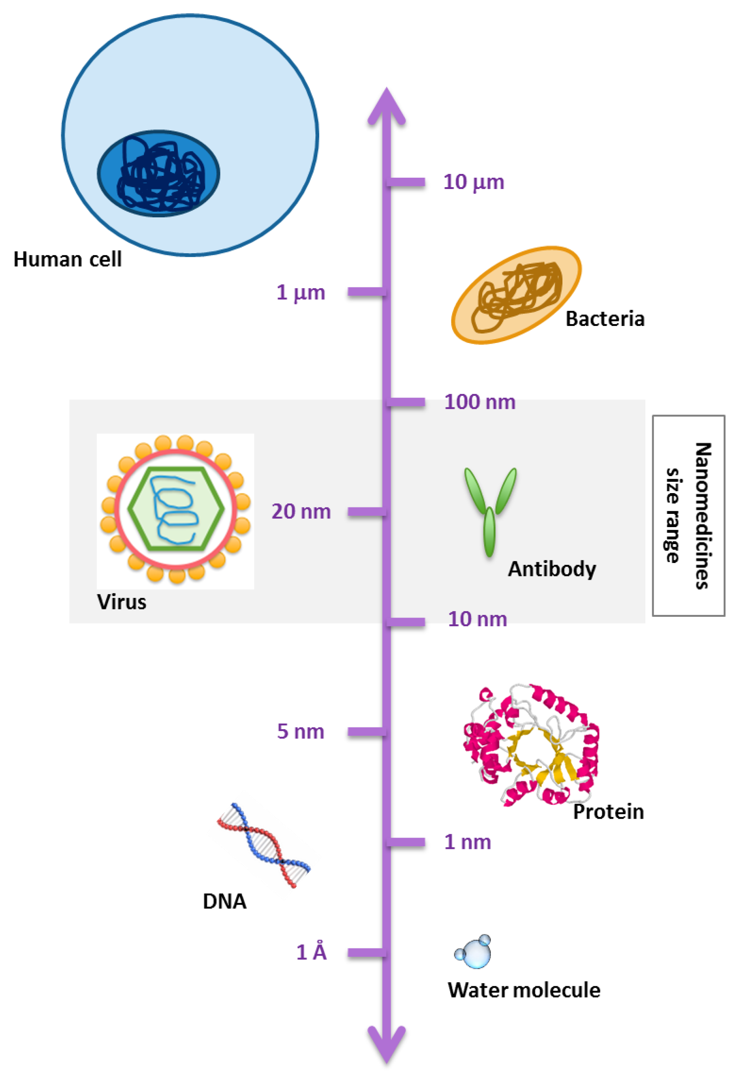
What is nanotechnology or nanomedicine?
What is nanotechnology or nanomedicine
Nanotechnology: Manipulation of matter on a nano scale
2004 European Science Foundation definition of nanomedicine:¹
‘The science and technology of diagnosing, treating and preventing disease and traumatic injury, of relieving pain, and of preserving and improving human health, using molecular tools and molecular knowledge of the human body’
Analytical tools²
Nanoimaging²
Nanomaterials and nanodevices²
Novel therapeutics and drug-delivery systems²
Clinical, regulatory and toxicological issues²
Figure adapted from Fornaguera and García-Celma 2017³
1. Satalkar P. Sci Eng Ethics 2016 Oct;22(5):1255–1276; 2. Mitchell MJ et al. Nature Reviews Drug Discovery 2020;20(2):101–124; 3. Fornaguera C and García-Celma MJ. J Pers Med 2017;7(4):12.

Slide 4
Nanoparticle functions
Nanoparticle functions
Nanoparticle function* | Subfunctions | Type of nanoparticles | Medical applications
Drug delivery | Delayed release Drug solubilisation | Porous silica Porous silicon Liposomes Micelles Polymer-based NPs | Deliver drug to diseased tissue
Specific targeting | Immunotargeting Receptor mediated Passive targeting | Porous silica Porous silicon Liposomes Micelles Polymer-based NPs | Translocate drug within the body to a specific site or pathogen
Triggered release | pH response Thermoresponsive Electroresponsive Ultrasound-induced release | Liposomes Polymer-based NPs Hydrogels | Control the release of a drug or action of a nanoparticle in a spatiotemporal manner
Thermal ablation | Photothermal ablation | Gold nanoshells Super-paramagnetic iron oxide NPs | Heat up tissues or cells near NP sites
Contrast agents | MRI agents X-ray enhancers Ultrasound | Gadolinium NPs Superparamagnetic iron oxide NPs | Enhance radiologic studies
Magnetism | Localised heating Particle accumulation | Super-paramagnetic iron oxide NPs | Control particles via magnetic fields outside the body
*General nanoparticle types are categorised by function and subfunction to describe their application towards areas of applied nanomedicine.
MRI, magnetic resonance imaging; NP, nanoparticle. Martinez JO et al. Chin Sci Bull 2012;57(31):3961–3971.

Slide 5
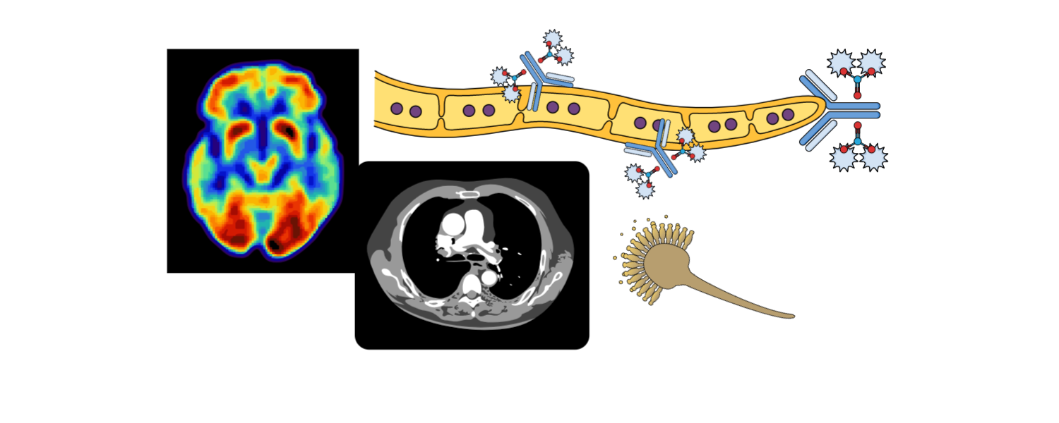
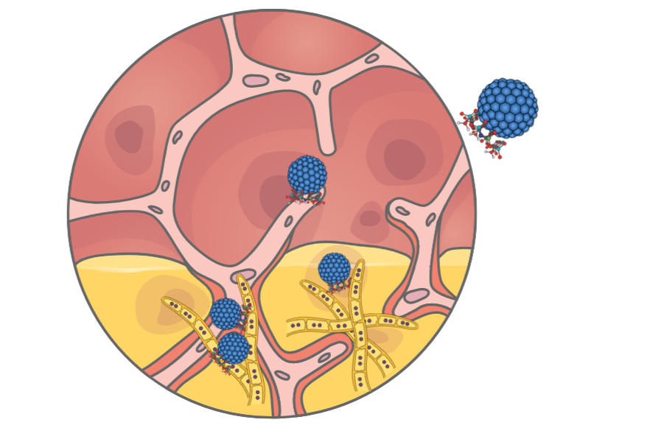
Nanomedicines Enormous promise for precision therapy in oncology and infectious diseases
Nanomedicines
Precision
diagnostics
Patient stratification
(disease biomarkers)
Targeted
drug delivery
Figure created by R. Lewis using Bioicons and Mind the Graph. Mitchell MJ et al. Nat Rev Drug Discov 2020;20(2):101–124.
Notes:
Figure created by R. Lewis using bioiocons and Mind the Graph

Slide 6
Nanoscale delivery approaches for small-molecule cargos^{1,2}
Nanoscale delivery
1. Mitchell MJ et al. Nat Rev Drug Discov 2021;20(2):101–124; 2. BioRender. Nanoscale Delivery Approaches for Small-Molecule Cargoes. Available at: https://app.biorender.com/biorender-templates/figures/all/t-626efb0f996a18cc8f8ce031-nanoscale-delivery-approaches-for-small-molecule-cargoes (accessed March 2023).

Slide 7
Advanced-generation nanocarriers What could this look like for antifungals?
Advanced generation nanocarriers
First generation
Second generation
Third generation
Drug
‘Stealth’ liposomes
that avoid MPS
sequestering, and target
damaged, inflamed or necrotic tissue to assemble and release
targeted (combination)
antifungal payload
Liposomes
‘Stealth’ liposomes
that avoid MPS
sequestering, and target
fungal antigens for
drug release
MPS, mononuclear phagocyte system.
Figure adapted from Martinez JO et al. Chin Sci Bull 2012;57(31):3961
–3971.
Walker L, Sood P, Lenardon MD, et al. MBio 2018; 9..
Notes:
A. First-generation nanocarriers (e.g., liposomes, micelles) primary role is to enclose therapeutic or diagnostic agents and then localize in tumours by the EPR effect; B. Second-generation nanocarriers improved by incorporating further modifications allowing for specific targeting via antibodies or other recognition biomolecules or “stealthing” from MPS sequestration; C. Third-generation nanocarriers advanced the field by creating platforms capable of incorporating and preforming multiple complex functions due to their nanoscale features (e.g., multistage silicon nanocarriers ability to deploy multiple waves of nanoparticles)

Slide 8
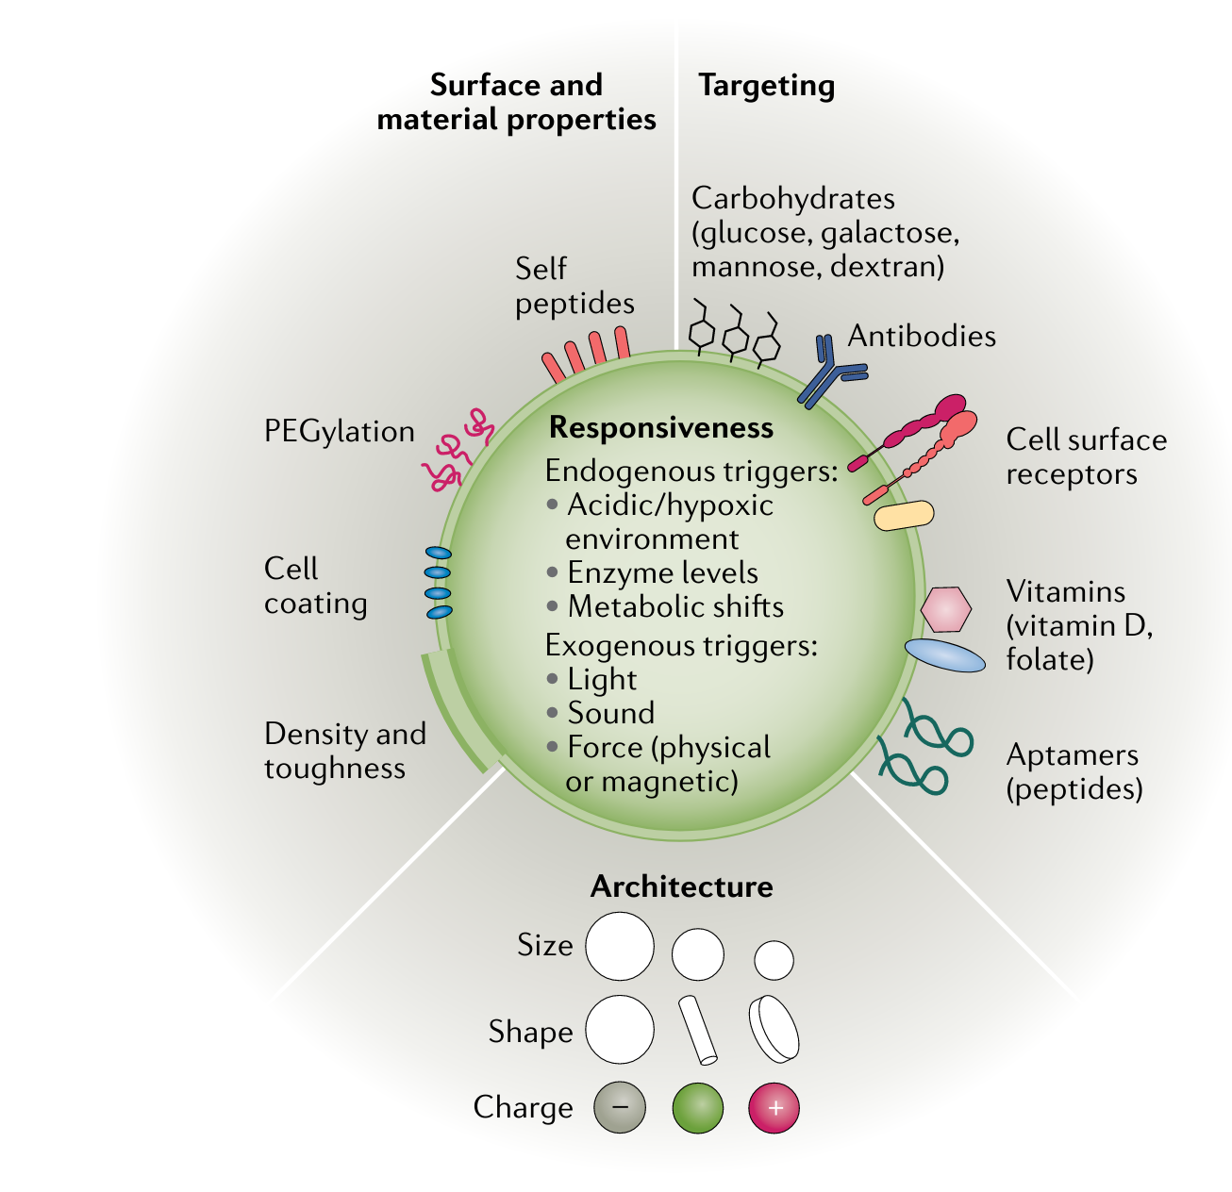
Engineering precision nanomedicines
Engineering precision nanomedicines
Mitchell MJ et al. Nat Rev Drug Discov 2021;20(2):101–124.

Slide 9
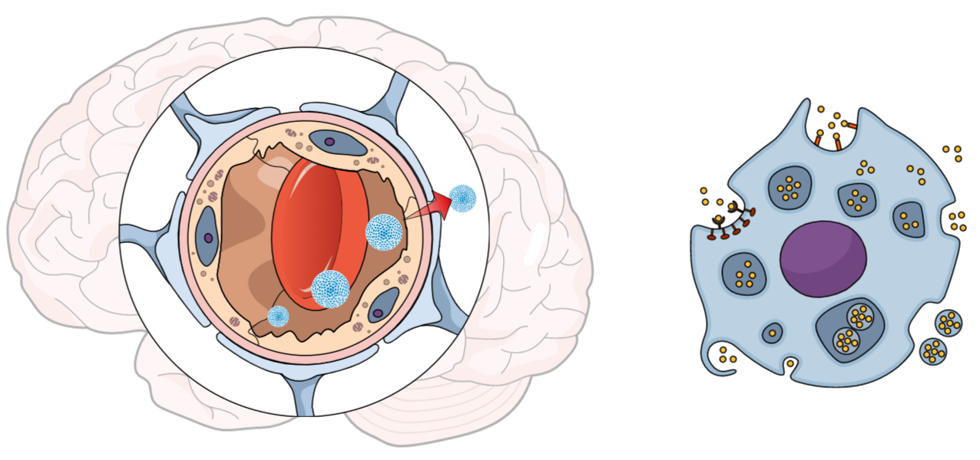
Nanomedicines can be designed to overcome biological barriers Overcoming pharmacokinetic/pharmacodynamic weaknesses of current agents
Nanomedicines can be designed to overcome
What barriers could be targeted for invasive fungal disease?
Anatomically restricted sites
(e.g. blood–brain barrier)
Uptake in immune/
epithelial cells
Tissue invasion/
necrosis
Biofilms
Figure created by R. Lewis in mindthegraph.com
Mitchell MJ et al. Nat Rev Drug Discov 2021;20(2):101–124.

Slide 10
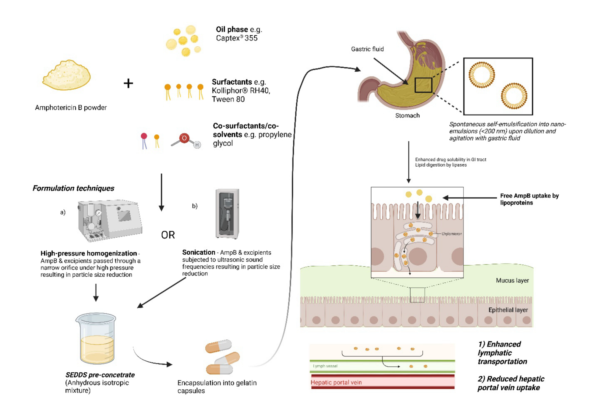
Nanomedicines can broaden patient populations who are not candidates for traditional therapies Oral amphotericin B therapy for leishmaniasis
Nanomedicines can broaden patient populations
Amphotericin B self-emulsifying formulations
Wasan E et al. Pharmaceutics 2022;14(11):2316.

Slide 11
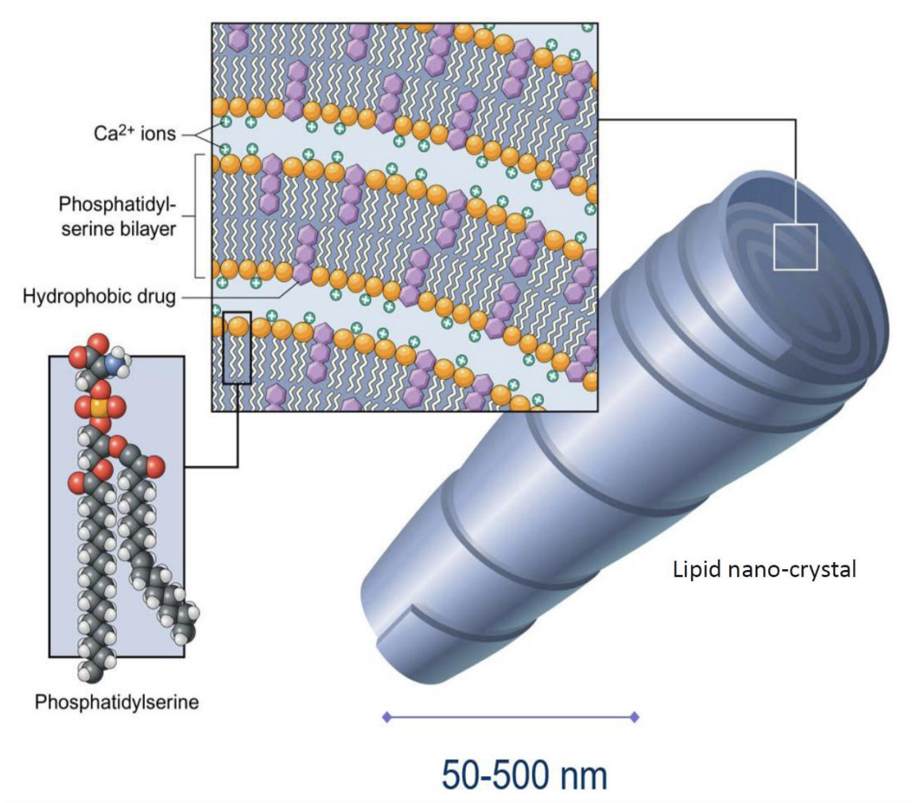
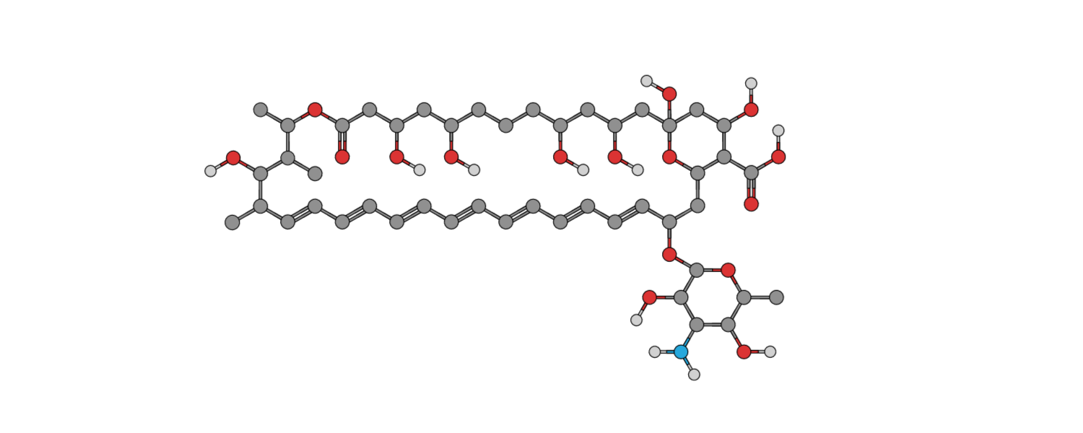
Lipid nanocrystals as a delivery platform for amphotericin B
Lipid nanocrystals
Cochleate formulations
Judeh ZMA et al. Nanomed Nanotechnol 2017;2(2):000119.

Slide 12
Liposomal amphotericin B (AmBisome®) Kidney-sparing effects are important in patients with neutropenia
Liposomal amphotericin (AmBisome)
The Kaplan–Meier lifetest analysis of the time until nephrotoxicity in the combined adult and childhood population
60
AMB-d 1 mg/kg/day
50
Liposomal AMB 3 mg/kg/day
40
Percentage of patients
30
Nephrotoxicity seen in12% of patients
20
10
p<0.001
0
0
3
5
7
9
11
13
15
17
19
21
23
25
27
Time until nephrotoxicity*/days
*Nephrotoxicity defined as doubling of serum creatinine.
AMB, amphotericin B. Prentice HG et al. Br J Haematol 1997;98(3):711–718.

Slide 13
Why are there still so few nanomedicines?
Why are there still so few nanomedicines
Drug | Company | Application | Date of first approval
Doxil® | Janssen | Kaposi’s sarcoma, ovarian cancer, multiple myeloma | 1995
DaunoXome® | Galen | Kaposi’s sarcoma | 1996
AmBisome® | Gilead Sciences | Fungal/protozoal infections | 1997
Visudyne® | Bausch and Lomb | Wet age-related macular degeneration, myopia, ocular histoplasmosis | 2000
Marqibo® | Acrotech Biopharma | Acute lymphoblastic leukaemia | 2012
Onivyde® | Ipsen | Metastatic pancreatic cancer | 2015
Vyxeos® | Jazz Pharmaceuticals | Acute myeloid leukaemia | 2017
Onpattro® | Alnylam Pharmaceuticals | Transthyretin- mediated amyloidosis | 2018
Oncaspar® | Servier Pharmaceuticals | Acute lymphoblastic leukaemia | 1994
Copaxone® | Teva | Multiple sclerosis | 1996
PegIntron® | Merck | Hepatitis C infection | 2001
Eligard® | Tolmar | Prostate cancer | 2002
Neulasta® | Amgen | Neutropenia, chemotherapy induced | 2002
Abraxane® | Celgene | Lung cancer, metastatic breast cancer, metastatic pancreatic cancer | 2005
Cimzia® | UCB | Crohn’s disease, rheumatoid arthritis, psoriatic arthritis, ankylosing spondylitis | 2008
Plegridy® | Biogen | Multiple sclerosis | 2014
ADYNOVATE® | Takeda | Haemophilia | 2015
INFeD® | Allergan | Iron-deficient anaemia | 1992
Dexferrum® | American Regent | Iron-deficient anaemia | 1996
Ferrlecit® | Sanofi | Iron deficiency in chronic kidney disease | 1999
Venofer® | American Regent | Iron deficiency in chronic kidney disease | 2000
Feraheme® | AMAG | Iron deficiency in chronic kidney disease | 2009
Injectafer® | American Regent | Iron-deficient anaemia | 2013
Lipid-based
Polymer-based
Inorganic
Mitchell MJ et al. Nat Rev Drug Discov 2021;20(2):101–124.

Slide 14
Unfulfilled promise in oncology and infectious diseases?
Unfulfilled promise
Nanomedicine: Is the wave cresting?¹
Rudy Juliano 2013
The field of nanomedicine has grown rapidly in recent years, but several issues are emerging that could constrain its future evolution, particularly if they are not appropriately acknowledged and the potential of nanomedicine is oversold.
Cancer nanomedicine: Is targeting our target?²
Lammers T et al. 2016
Nanomedicine may have a delivery problem. Rigorous, realistic and holistic rethinking is needed to improve nanomedicine performance and increase patient benefit.
Cancer nanomedicines: So many papers and so few drugs!³
Venditto VJ and Szoka FC Jr 2013
This review identifies a timeline to nanomedicine anticancer drug approval using the business model of inventors, innovators and imitators. By evaluating the publication record of nanomedicine cancer therapeutics, we identified a trend of very few publications prior to FDA approval.
Nanomedicine(s) under the microscope⁴
Duncan R and Gasper R. 2011
Depending on the context, nanotechnologies developed as nanomedicines (nanosized therapeutics and imaging agents) are presented as either a remarkable technological revolution already capable of delivering new diagnostics, treatments for unmanageable diseases and opportunities for tissue repair or highly dangerous nanoparticles, nanorobots, or nanoelectronic devices that will wreak havoc in the body.
FDA, US Food and Drug Administration. 1. Juliano R. Nat Rev Drug Discov 2013;2(3):171–172; 2. Lammers T et al. Nat Rev Mater 2016;(9):16069; 3. Venditto VJ and Szoka FC Jr. Adv Drug Deliv Rev 2013;65(1):80–88; 4. Duncan R and Gasper R. Mol Pharm 2011;8(6):2101–2141.

Slide 15
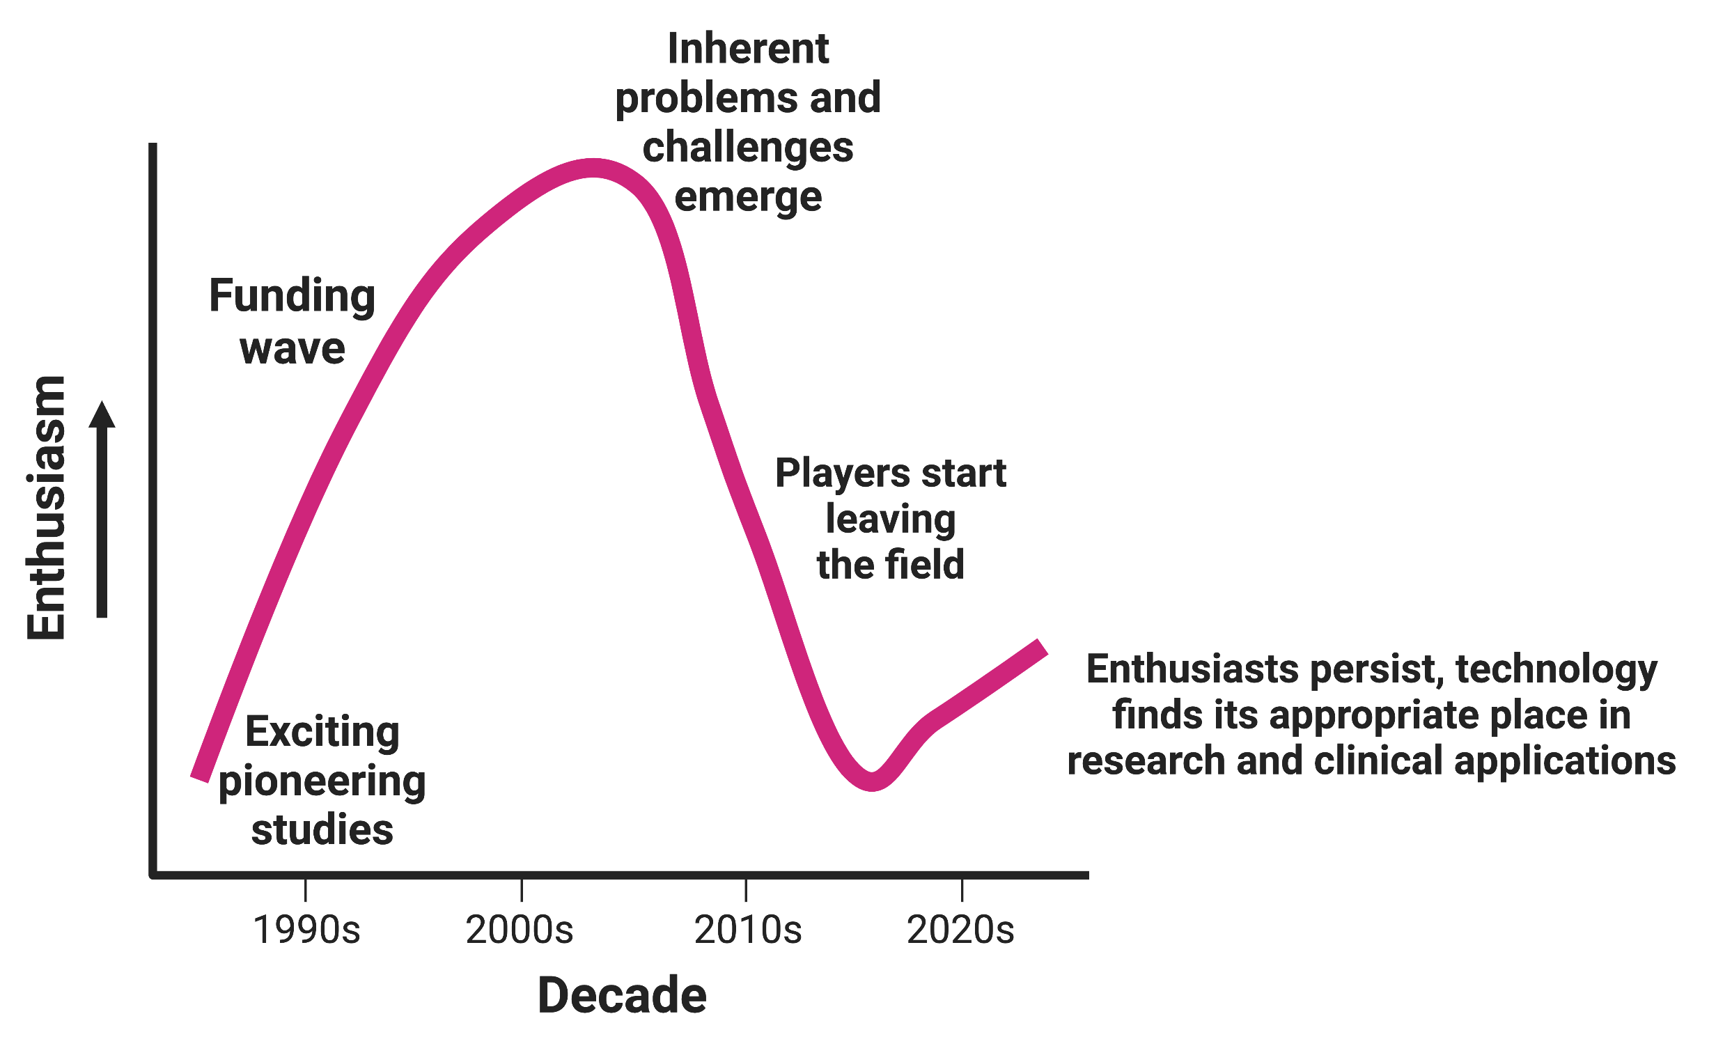
Nanomedicines Following the classic biomedical technology lifecycle
Nanomedicines Following the classic biomedical
Technologies life cycle^{1,2}
Large-scale (sequestered) research funding¹
Established for nanomedicines by
US NCI Alliance for Nanotechnology in Cancer (centres of excellence)¹
US National Health Lung and Blood Institute’s PEN¹
Eight NIH-funded nanomedicine development centres¹
NIH no longer accepting targeted applications in nanomedicine¹
All submissions must go through traditional NIH mechanisms competing with other areas still receiving targeted funding (microbiome, global health, undiagnosed diseases)¹
NCI, National Cancer Institute; NIH, National Institute of Health; PEN, Program of Excellence in Nanotechnology.
1. Juliano R. Nat Rev Drug Discov 2013;12(3):171–172; 2. Speaker’s own experience.

Slide 16
Journal of Antimicrobial Chemotherapy
Journal
Supplement 2
‘30 years in fulfilling unmet medical need for the evolving patient at risk for invasive fungal infections – Liposomal amphotericin B’
J Antimicrob Chemother 2022;77(Suppl_2). Pages ii1–ii34.

Slide 17
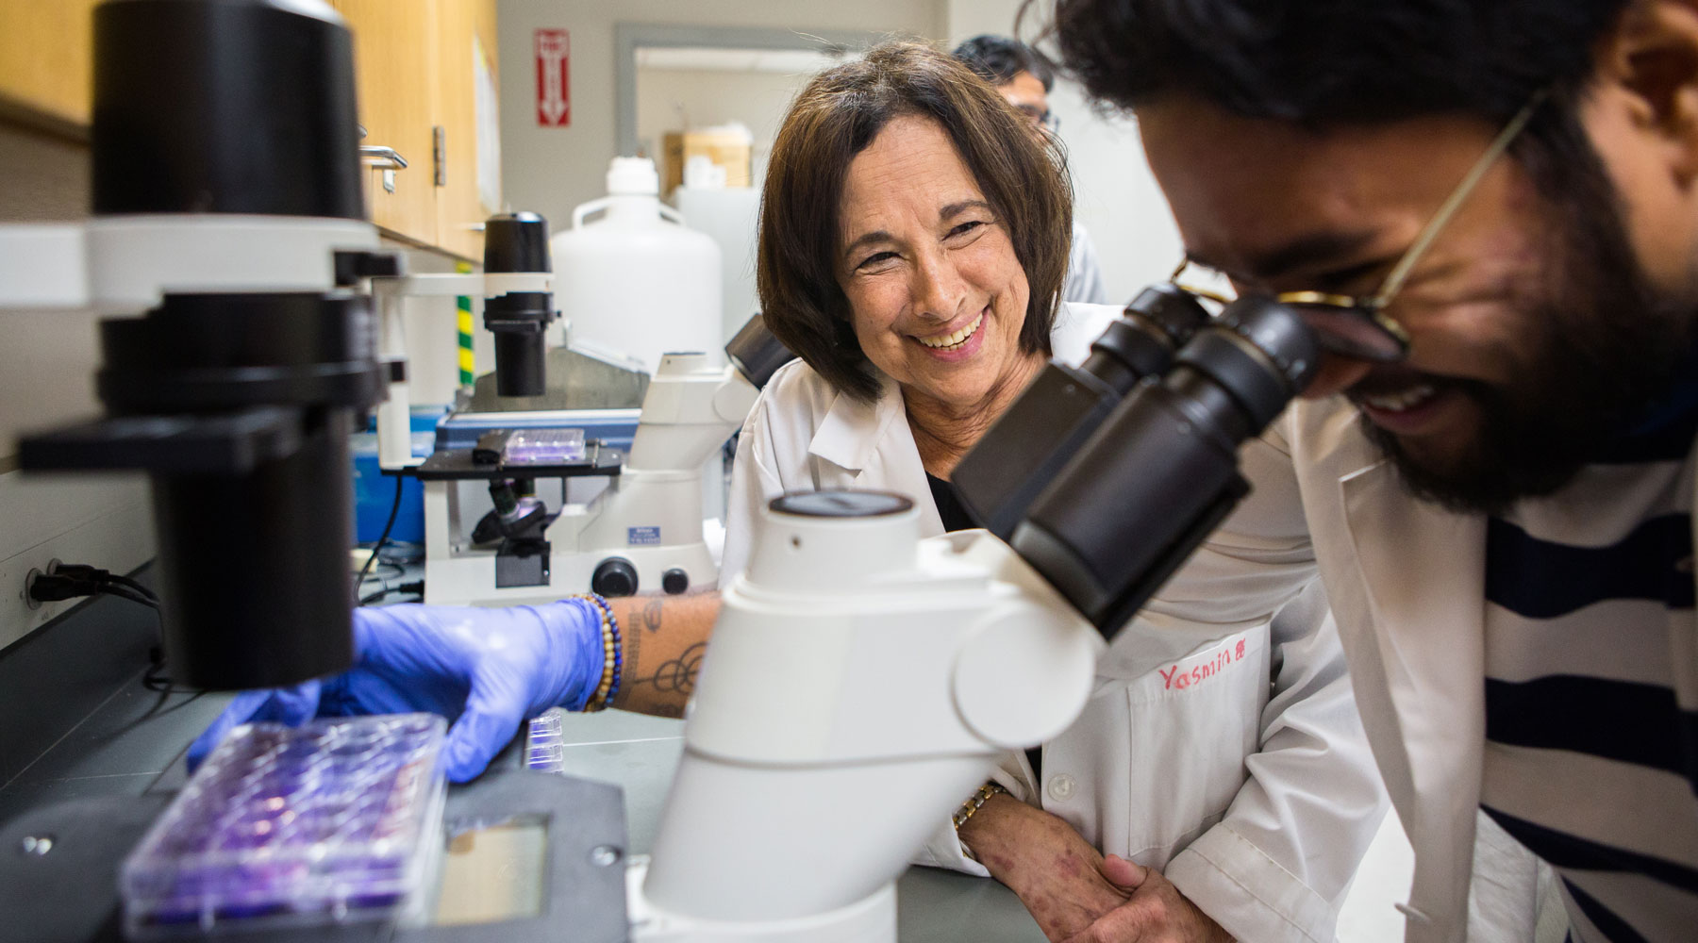
Lessons learned from liposomal amphotericin B (AmBisome)^{1,2} A short history of a successful nanomedicine
Lessons learned
1970s: Birth of engineered versions of naturally occurring structures: liposomes
1980s: Several companies were established to develop liposome-based therapeutics
Vestar Inc. (California): Engineered small liposomes (<100 nm) for cancer therapeutics that featured single-bilayer membranes, neutral net particle charge, and a lipid bilayer motif of distearoylphosphatidylcholine and cholesterol in a 2:1 molar ratio
Special production methods were used to create rigid, stable drug carriers at human-body temperature with:
Low clearance rates by liver, kidney and macrophages
Extended plasma lifetime and tissue distribution
Vestar’s liposomes were modified with distearoyl phosphatidylglycerol (negative charge), and amphotericin B was inserted into the bilayer, taking advantage of natural binding to cholesterol → ‘AmBisome’
Prof. Jill Adler-Moore
Amphotericin B
Figure adapted from Martinez et al. 2012²
1. Brüggemann RJ et al. J Antimicrob Chemother 2022;77(Suppl_2):ii3–ii10; 2. Martinez JO et al. Chin Sci Bull 2012;57(31):3961–3971.

Slide 18
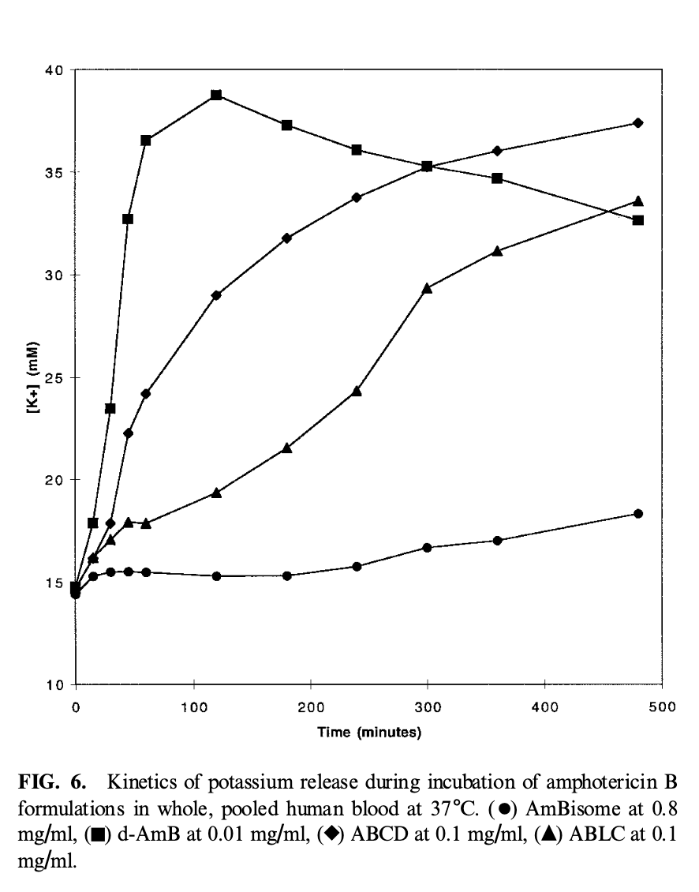
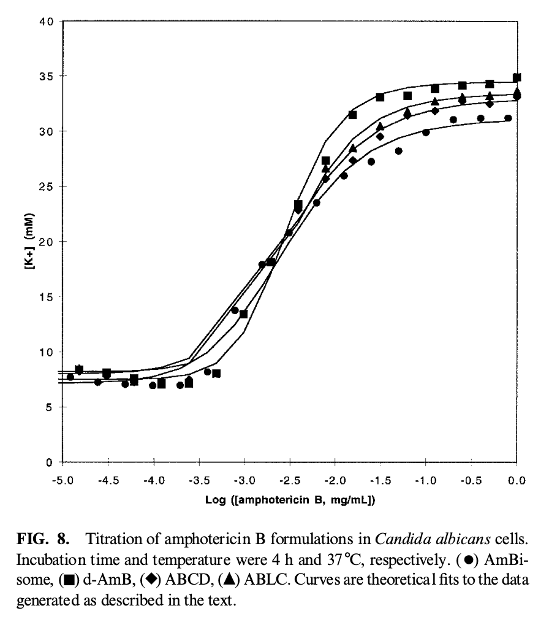
The liposome reduces ‘off-target’ delivery of amphotericin B…
The liposome reduces
Potassium release by RBCs
Potassium release by C. albicans
ABCD
ABLC
d-AMB
L-AMB
ABCD, amphotericin B colloidal dispersion; ABLC, amphotericin B lipid complex; d-AMB, deoxycholate amphotericin B; L-AMB liposomal amphotericin B; RBC, red blood cell. Jensen GM et al. Drug Delivery 1999 Jan 1;6(2):81–88.

Slide 19
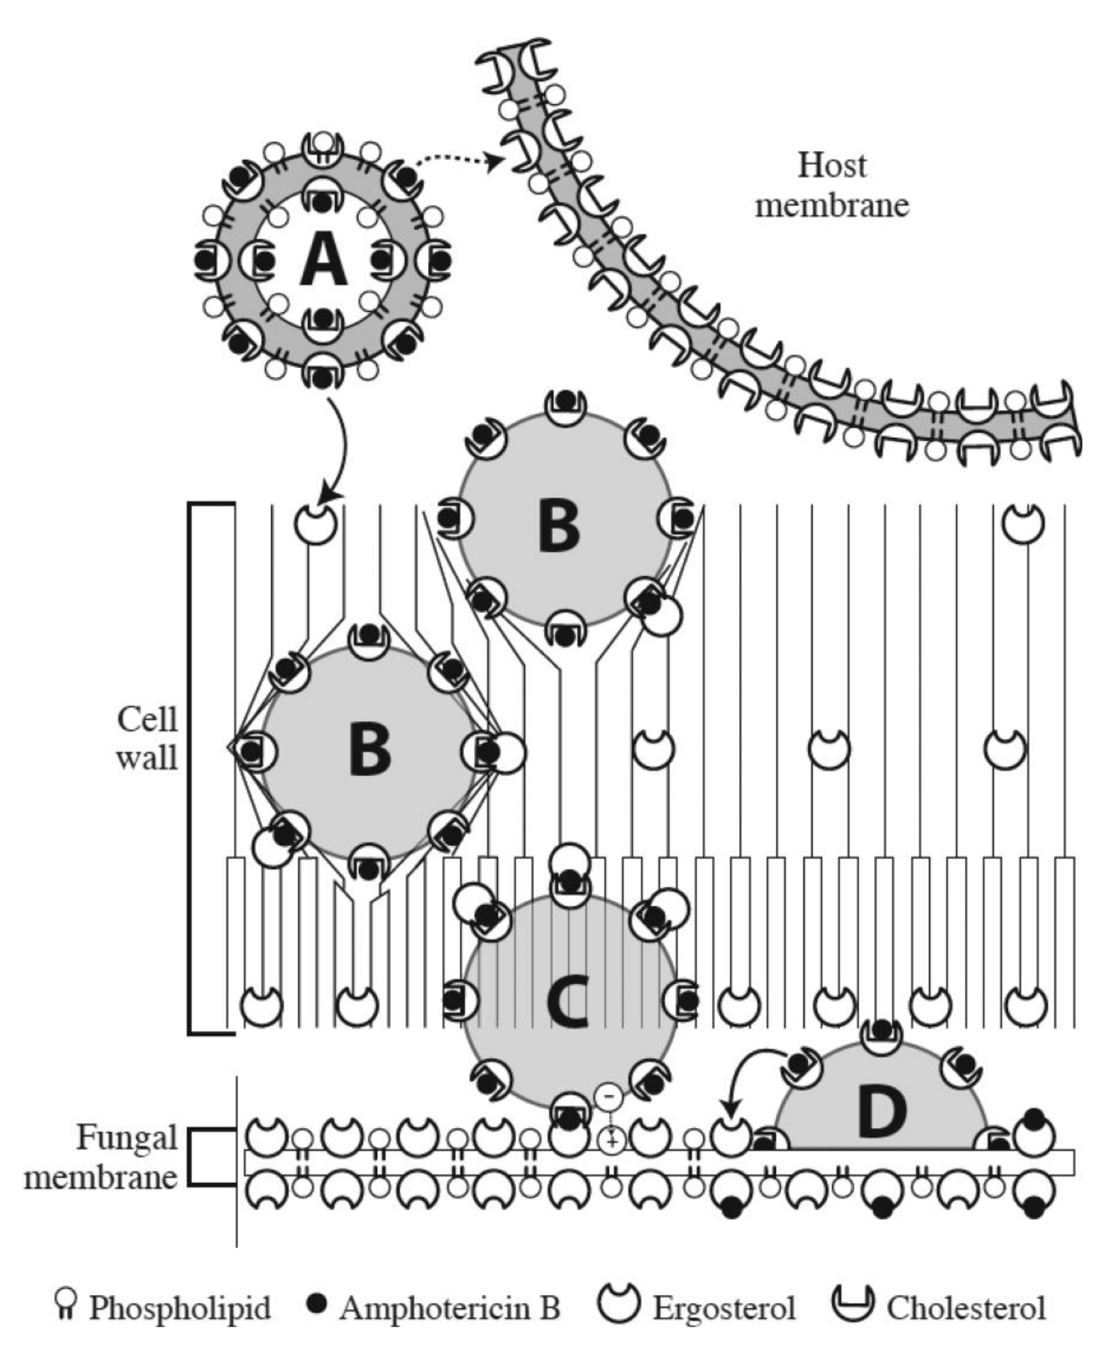
…While maintaining delivery to fungal targets
While maintaining delivery to fungal targets
TEM images of C. albicans*¹
Mechanistic elements of liposomal amphotericin B
*C. albicans SC5314 incubated with 12 g/ml amphotericin B, showing intact liposomes in the outer (a, c, and d) and inner (a, b, c, and e) cell wall and at the cell membrane (f), indicated by arrows. The granular particles in the cytoplasm are ribosomes, not liposomes. Bars, 100 nm. TEM, transmission electron microscopy.
1. Walker L et al. mBio 2018;9(1):e02383–17; 2. Brüggemann RJ et al. J Antimicrob Chemother. 2022;77(Suppl_2):ii3–ii10.

Slide 20
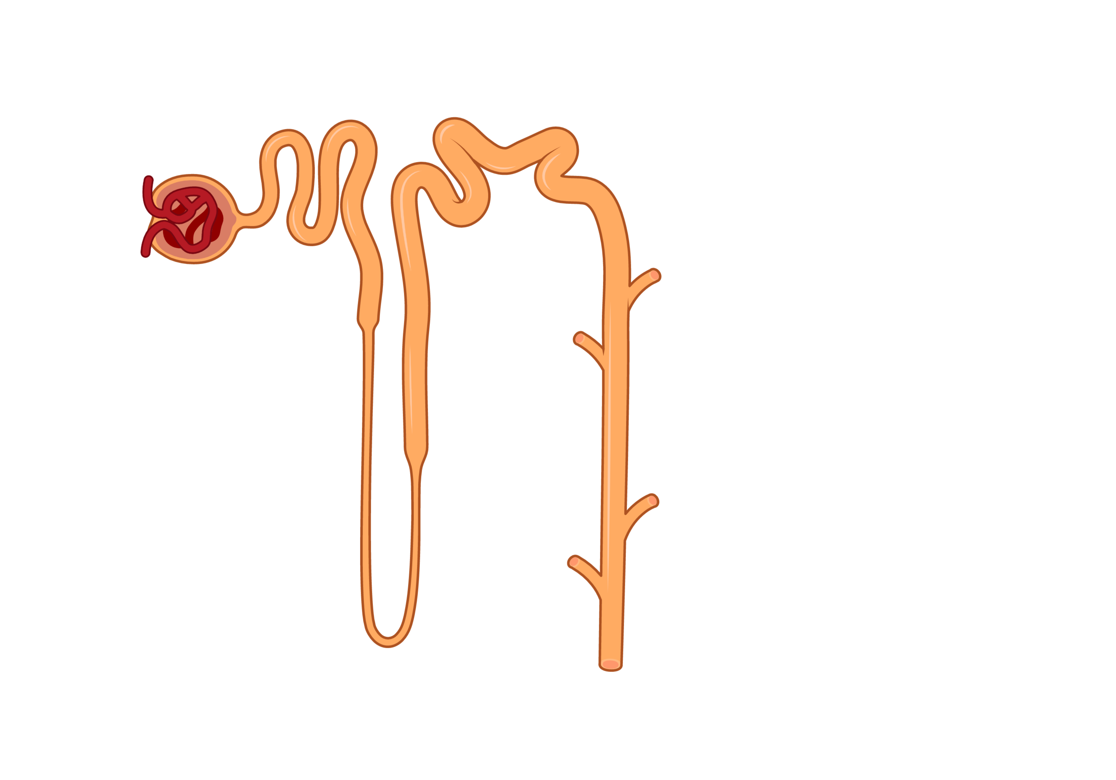
Liposomes reduce the off-target effects of amphotericin B on the kidney
Liposomes reduce (1of1)
Constriction of
afferent arterioles²
Nephron¹
LDL-bound AMB accumulates in kidney tubules
(LDL receptors)
Direct damage to proximal and
distal tubules; loss of K⁺, Mg⁺⁺²
Tubular-glomerular feedback; further constriction of afferent arterioles²
Excessive secretion of Na⁺, K⁺²
Severe Na⁺, K⁺ and Mg⁺⁺ wasting → decreased GFR → hypoxia → acute tubular necrosis (in 10 clinical trials = AMBd associated with ≥2-fold increase in SCr in 26%)³
AMB, amphotericin B; GFR, glomerular filtration rate; LDL, low-density lipoprotein; LDL-R2, low-density lipoprotein receptor 2; SCr, serum creatinine.
1. BioRender. Nephron. Available at: https://www.biorender.com/icon/nephron (accessed March 2023); 2. Adler-Moore J et al. Clin Infect Dis 2019;68:S244–S259; 3. Botero Aguirre JP and Restrepo Hamid AM. Cochrane Database Syst Rev 2015;(11):CD010481.

Slide 21
Liposomes reduce the off-target effects of amphotericin B on the kidney
Liposomes reduce (2of2)
Constriction of
afferent arterioles²
Nephron¹
LDL-bound AMB accumulates in kidney tubules
(LDL-R2 receptor)
Direct damage to proximal and
distal tubules; loss of K⁺, Mg⁺⁺²
Liposomes do not undergo
tubular glomerular filtration^{2,3}
Liposomes reduce AMB binding to LDL
receptors; ↓ accumulation³
Tubular-glomerular feedback; further constriction of afferent arterioles²
Excessive secretion of Na⁺, K⁺²
(In 10 clinical trials = L-AMB associated with ≥2-fold increase in SCr in 10%)⁴
AMB, amphotericin B; GFR, glomerular filtration rate; L-AMB, liposomal amphotericin B, LDL, low-density lipoprotein; LDL-R2, low-density lipoprotein receptor 2; SCr, serum creatinine.
1. BioRender. Nephron. Available at: https://www.biorender.com/icon/nephron (accessed March 2023); 2. Adler-Moore J et al. Clin Infect Dis 2019;68:S244–S259; 3. Brajtburg J and Bolard J. Clin Microbiol Rev 1996;9:512–531; 4. Botero Aguirre JP, Restrepo Hamid AM. Cochrane Database Syst Rev 2015;(11):CD010481

Slide 22
Comparison of liposomal amphotericin B pharmacokinetics with conventional amphotericin B (CAB)
Comparison of liposomal amphotericin B pharmacokinetics
Serum pharmacokinetic profile¹
L-AMB
5 mg/kg/day
CAB
0.6 mg/kg/day
Higher
Parameter
Cmax (mcg/mL)
AUC (mcg·hr/mL)
Vd (L/kg)
Cl (mL/hr/kg)
83.0
555
0.11
11
1.1
17.1
5
38
L-AMB tissue exposures
versus CAB
Lower
AUC, area under the curve; CAB, conventional amphotericin B; Cl, clearance; Cmax, maximum serum concentration; L-AMB, liposomal amphotericin B; Vd, volume of distribution. 1. Groll AH et al. Adv Pharmacol 1998;44:343–500; 2. Groll AH et al. Clin Infect Dis 2019;68(Suppl 4):S260–S274.

Slide 23
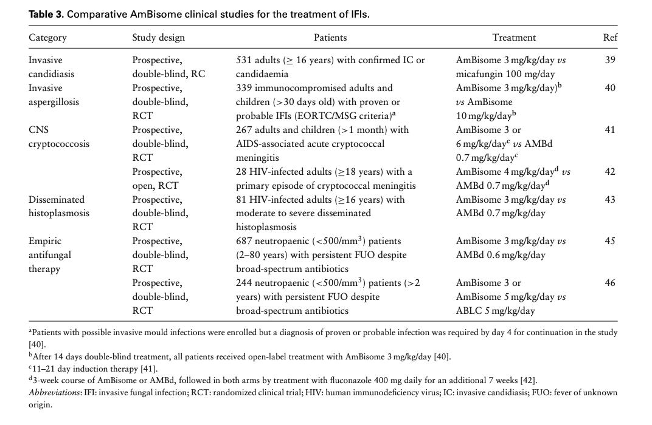
Liposomal AMB Summary of key clinical studies
Open Health: Can you provide and acceptable summary slides of clinical trials supporting
AmBisome efficacy (indications) showing mainline results and toxicity difference vs. comparators
Something paired down from Table 2: Groll AH, Rijnders BJA, Walsh TJ, Adler-Moore J, Lewis RE, Brüggemann RJM. Clinical Pharmacokinetics, Pharmacodynamics, Safety and Efficacy of Liposomal Amphotericin B. Clin Infect Dis. 2019;68:S260-S274. or similar to the Adler Moore table but showing topline results?

Slide 24
Liposomal amphotericin B Summary of key clinical studies
Indication | Study/design | Efficacy endpoints | Main results | Toxicity
Persistent fever and neutropenia | Walsh 1999: Randomised, double-blind study that aimed to compare AmBisome and conventional amphotericin B as empirical treatment in patients with persistent fever and neutropenia (N=687) | Treatment success (composite of five components)† | Treatment success rate AmBisome: 50.1% Conventional amphotericin B: 49.4% Comparable overall treatment success rate with AmBisome vs conventional amphotericin B | AmBisome was associated with significantly less infusion-related toxicity (12% vs 26%, p=0.001) and nephrotoxicity (10% vs 29%, p=0.001)
Persistent fever and neutropenia | Wingard 2000: Randomised, double-blind, comparative study to evaluate the safety of empirical treatment with AmBisome vs ABLC in neutropenic patients with a suspected fungal infection (N=244) | Frequency of infusion-related chills/rigors during infusion or for up to 1 hour after infusion on the day of the first dose (Day 1) | Infusion-related chills/rigors at Day 1 AmBisome 3 mg/kg/day:‡ 18.8% AmBisome 5 mg/kg/day:‡ 23.5% ABLC: 79.5% Significantly lower rate of infusion-related chills/rigors with both AmBisome doses vs ABLC | AmBisome treatment resulted in fewer incidences of nephrotoxicity vs ABLC AmBisome led to fewer treatment discontinuations due to toxicity vs ABLC AmBisome led to fewer infusion-related reactions vs ABLC AmBisome reduced the need for medication to treat and prevent infusion-related reactions
p=0.046
*Patients were admitted to 33 hospitals in Spain between 1 February 2006 and 31 January 2007, and treated with AmBisome; †Survival for 7 days after initiation of the study drug, resolution of fever during the period of neutropenia, successful treatment of any baseline fungal infection, if present, absence of breakthrough fungal infections during administration of the study drug or within 7 days after the completion of treatment, absence of premature discontinuation of the study drug because of toxicity or lack of efficacy; ‡p≤0.001 for AmBisome vs ABLC (Fisher’s exact test).
ABLC, amphotericin B lipid complex; ICU, intensive care unit; RIFLE, risk, injury, failure, loss, end-stage kidney disease; SCr, serum creatinine.

Slide 25
Liposomal amphotericin B Summary of key clinical studies
Indication | Study/design | Efficacy endpoints | Main results | Toxicity
Visceral leishmaniasis | Sundar 2010: Open-label, randomised study that aimed to determine whether the efficacy of a single infusion of AmBisome was inferior to 15 alternate-day infusions of DAmB (N=395) | Overall cure rates 6 months after treatment with AmBisome or DAmB | Overall cure rates in the ITT population AmBisome: 95.7% DAmB: 96.3% A single-dose regimen of AmBisome demonstrated efficacy and non-inferiority in comparison with DAmB in the treatment of visceral leishmaniasis | Single dose of AmBisome was not associated with any safety concerns in adults or children Fewer infusion-related fevers or rigors and overall AEs were associated with a single-dose regimen of AmBisome vs the DAmB group
Persistent fever and neutropenia | Walsh 2002: Open-label, prospective, randomised, comparative trial that aimed to assess the efficacy and safety of AmBisome vs voriconazole as empirical antifungal therapy in patients with persistent fever and neutropenia (N=837) | Overall success rate (composite of five components)* | Overall success rate AmBisome: 30.6% Voriconazole: 26.0% Voriconazole did not fulfil the protocol-defined criteria for non-inferiority to AmBisome with respect to overall response to empirical therapy | There was no significant difference between AmBisome and voriconazole regarding the proportion of patients with serum creatinine level >2.0 times the baseline level
Persistent fever and neutropenia | Walsh 2004: Randomised, double-blind study that aimed to assess the efficacy and safety of AmBisome vs caspofungin as empirical antifungal therapy (N=1123) | Favourable overall response (five-component endpoint)† | Overall response AmBisome: 33.7% Caspofungin: 33.9% Comparable overall treatment success rate with AmBisome vs caspofungin | Significantly fewer patients experienced nephrotoxicity (p<0.001), an infusion-related event (p<0.001), a drug-related AE (p<0.001) or treatment discontinuation due to a drug-related AE (p=0.04) with caspofungin vs AmBisome
*Treatment was considered successful if all five of the following criteria were met: no breakthrough fungal infection; survival for 7 days after initiation of the study drug; absence of premature discontinuation of the study drug; resolution of fever during the period of neutropenia; successful treatment of any baseline fungal infection; †Treatment was considered successful if all five of the following criteria were met: successful treatment of any baseline fungal infection; absence of breakthrough fungal infection during therapy or within 7 days after the completion of therapy; survival for 7 days after the completion of therapy; no premature discontinuation of study therapy because of drug-related toxicity or lack of efficacy; resolution of fever (temperature <38°C for ≥48hours) during neutropenia.
AE, adverse event; DAmB, amphotericin B deoxycholate; ITT, intention-to-treat.

Slide 26
Liposomal amphotericin B Summary of key randomized clinical studies
Indication | Study/design | Efficacy endpoints | Main results | Toxicity
Candidaemia and invasive candidiasis | Kuse 2007: Phase 3, randomised, double-blind, non-inferiority study that aimed to compare micafungin with AmBisome in the treatment of adult patients with candidaemia or invasive candidiasis (N=531) | Response rate based on investigator-assessed overall treatment success (clinical and mycological response at end of therapy) | Response rate AmBisome: 89.5% Micafungin: 89.6% Comparable overall treatment success rate with AmBisome vs micafungin | Overall numbers of AEs and serious AEs leading to treatment discontinuation were not significantly different with AmBisome vs micafungin Infusion-related AEs were more frequent in patients treated with AmBisome vs micafungin
Mucormycosis | Lanternier 2015: Prospective pilot study that aimed to evaluate the efficacy and safety of high-dose (10 mg/kg/day) AmBisome monotherapy in initial mucormycosis treatment (N=34) | Percentage of overall favourable responses (complete or partial response) at Week 4 (or before if treatment ended earlier), according to the Herbrecht evaluation criteria* | Favourable responses at Week 4 or end of treatment Favourable overall response: 36% Partial response: 18% Complete response: 18% | AEs related to AmBisome:
Invasive mould infections | Cornely 2007: Prospective, randomised, double-blind study that aimed to establish the efficacy and optimal dose of AmBisome in invasive aspergillosis and other mould infections (N=331) | Favourable (complete or partial) response at the end of study drug treatment | Favourable overall response AmBisome 3mg/kg: 50% AmBisome 10mg/kg: 46% | Higher rates of nephrotoxicity and hypokalaemia were seen with high-dose AmBisome (10 mg/kg/day) vs standard dose (3 mg/kg/day)
 |  |  | Complete response AmBisome 3mg/kg: 1% AmBisome 10mg/kg: 2%
 |  |  | Partial response AmBisome 3mg/kg: 49% AmBisome 10mg/kg: 44%
 |  |  | Comparable favourable overall response rates were observed between treatment subgroups
*Complete response: resolution of all clinical signs and symptoms and >90% of the lesions due to invasive aspergillosis that were visible on radiology. Partial response: clinical improvement and >50% improvement in findings on radiology; †Includes those with hypokalaemia <2.5 mmol/L; ‡Defined by the investigator.
AE, adverse event.

Slide 27
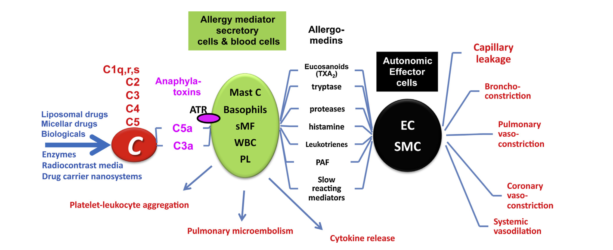
Unique adverse effects with nanoparticle formulations Complement activation-related pseudoallergy (CARPA)
Unique toxicities
Risk increased if nanoparticle >100 nm
ATR, anaphylatoxin receptors; EC, endothelial cells; PL, platelets; PAF, platelet-activating factor, SMC, smooth muscle cells; sMF, secretory macrophages; TXA2, thromboxane A2; WBC, white blood cell.
Szebeni J. Mol Immunol 2014;61(2):163–173.

Slide 28
Not all lipid-based nanomedicines are the same
All lipid-based nanomedicines are not the same
Results of preclinical studies comparing AmBisome with Anfogen® or Lambin®
 | AmBisome vs Anfogen |  | AmBisome vs Lambin
 | AmBisome | Anfogen | AmBisome | Lambin
Median diameter of liposomes (nm) | 77.8 | 111.5 | 77.8 | 122.2
RBC toxicity (K₅₀ µg/ml) | 20 | 0.9 | 7.4 | 1.4
Maximum tolerated single IV dose (mg/kg) | >100 | 10 | >50 | 20
BUN at 7.5 mg/kg | 12 (normal) | 78 | NL | NL
Renal tubular necrosis with daily 5 mg/kg dosing in uninfected mice | Normal renal tubules | Renal tubular dilation | Normal renal tubules | Renal tubular dilation
Survival following A. fumigatus challenge and drug treatment | 7.5 mg/kg,4X: 100% | 7.5 mg/kg,4X: 70% | 10 mg/kg, 6X: 60% | 10 mg/kg, 6X: 30%
BUN, blood urea nitrogen; IV, intravenous; NL, within normal limits; RBC, red blood cell. Adler-Moore JP et al. Med Mycol 2016;54(3):223–231.

Slide 29
Shifting the balance between off-target and on-target drug localisation
Shifting
Liposomal amphotericin B: Reduced accumulation in kidney tubules → reduced dose-limiting nephrotoxicity
PEGylated liposomal doxorubicin: Reduced drug accumulation in heart → reduced dose-limiting cardiomyopathy → easier to use in combination regimens → less hair loss
Albumin–paclitaxel: Shorter infusion time, less need for corticosteroid and/or antihistaminic co-medications → improved ability to increase drug doses → more favourable performance with combination regimens
Lammers T et al. Nat Rev Mater. 2016 Sep 7;1(9):1–2.

Slide 30
Conclusions: The future of nanomedicine formulations for invasive fungal diseases
Precedent for clinical benefit: Addressing bioavailability problems and pharmacodynamic modulation to reduce off-target toxicities
Unknown clinical benefit: Improved targeting of infected tissue, improved drug delivery at the site of infection → improved efficacy?
Can this be advanced without biomarkers, improved diagnostic imaging?
Nanomedicine efficacy is often tested in broad populations, in which the vast heterogeneity of biological barriers in patients could mask the potential success in smaller subgroups
Nanomedicines have enormous potential for improving precision medicine and have improved the effectiveness of existing antifungal therapies

